Slide 1

Around the apple and down the leaf.

Slide 2

Down the bat and around the ball.

Slide 3

Curl around the caterpillar.

Slide 4

Around his back then head to toe.

Slide 5

Under his ear and around his trunk.

Slide 6
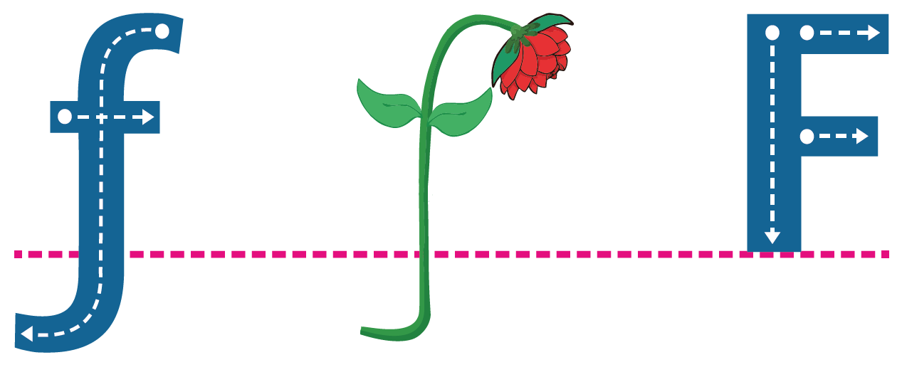
Down the flower and across the leaves.

Slide 7
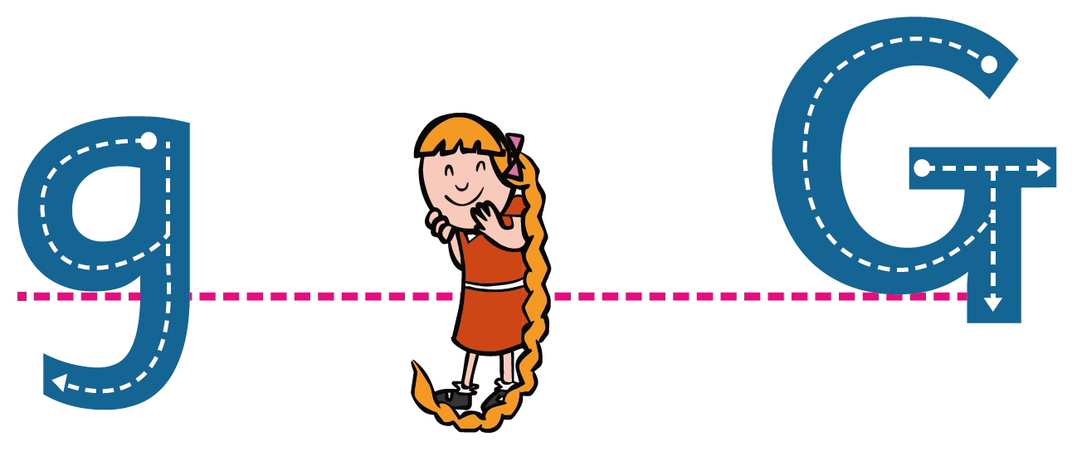
Left around the girl, down her plait and curl.

Slide 8
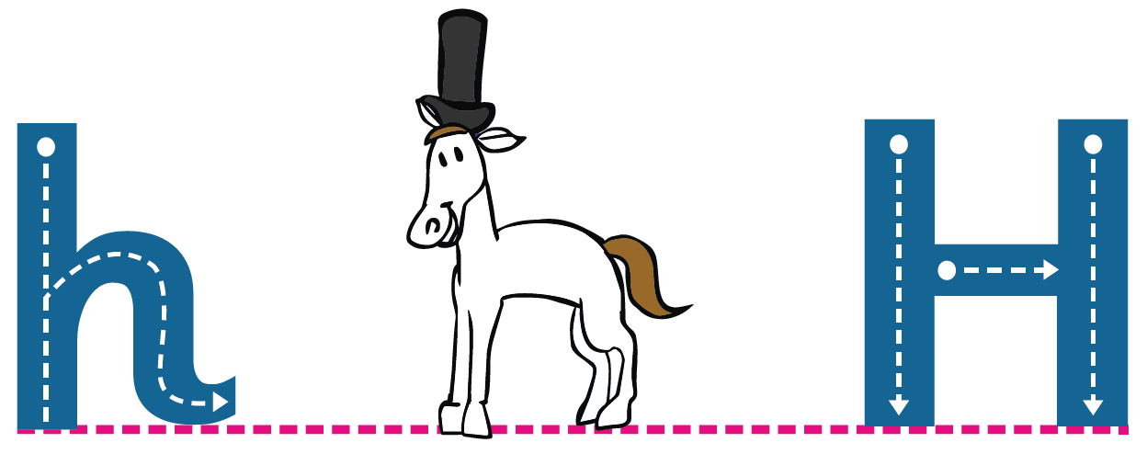
From head to toe and over his back.

Slide 9
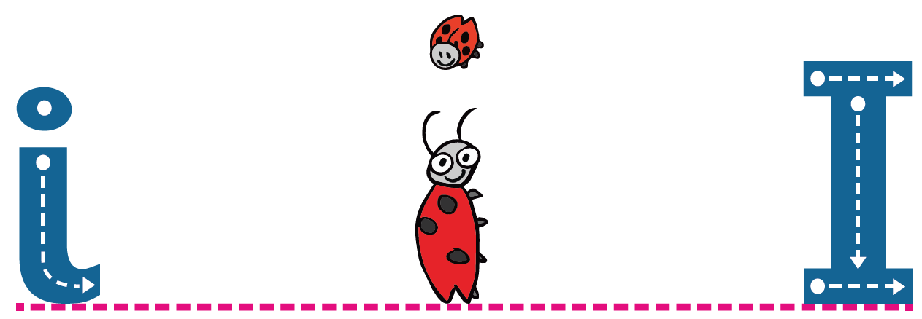
Down the insect, lift and dot.

Slide 10
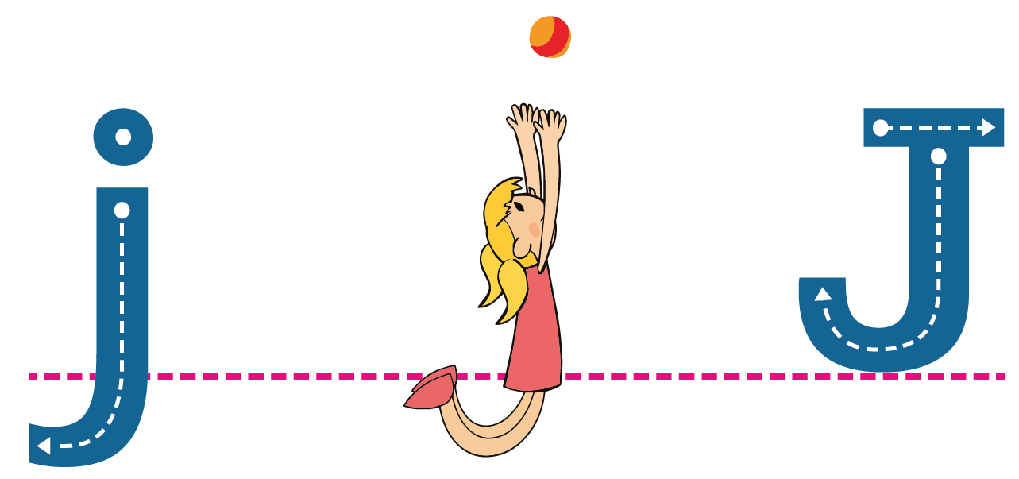
Down Jane’s back, up to her toes.
Jump to the ball.

Slide 11
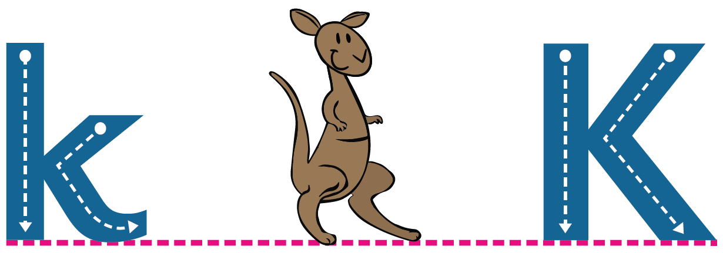
From head to toe, arm up, kick out.

Slide 12
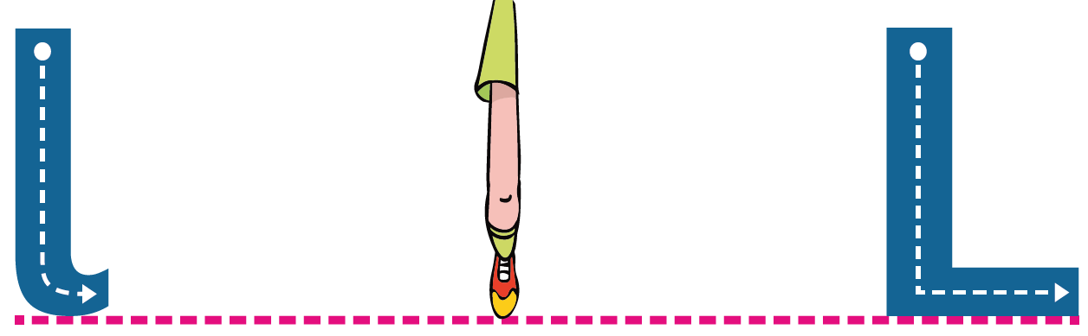
Down the long, long leg.

Slide 13

From the man go down,
climb one mountain then the other.

Slide 14

From head to toe and over the net.

Slide 15
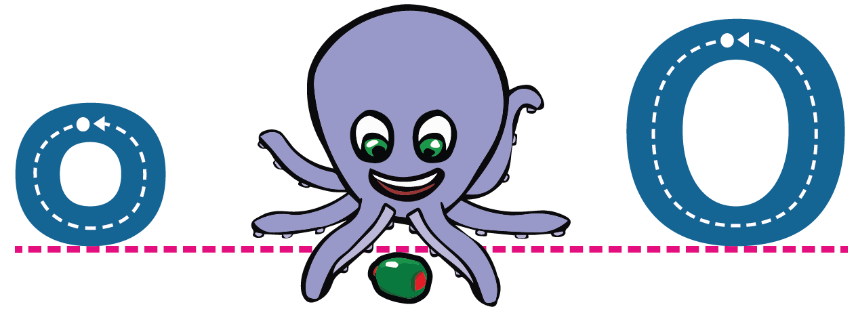
From the top of the head and
all the way round the octopus.

Slide 16
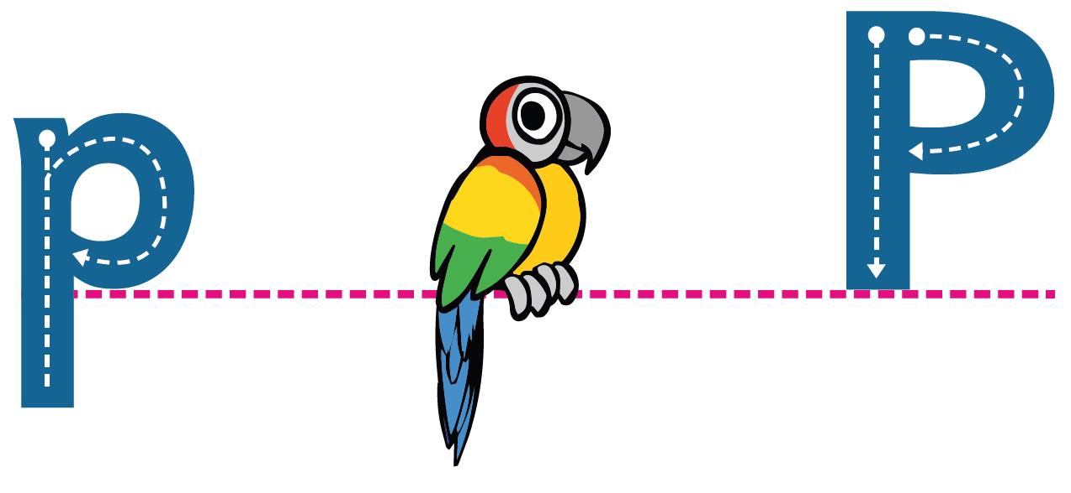
From head to tail then right around the parrot.

Slide 17
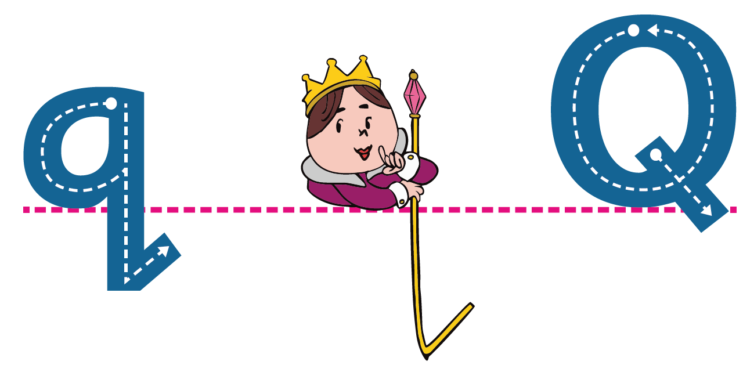
Right around the queen and way down her staff.

Slide 18
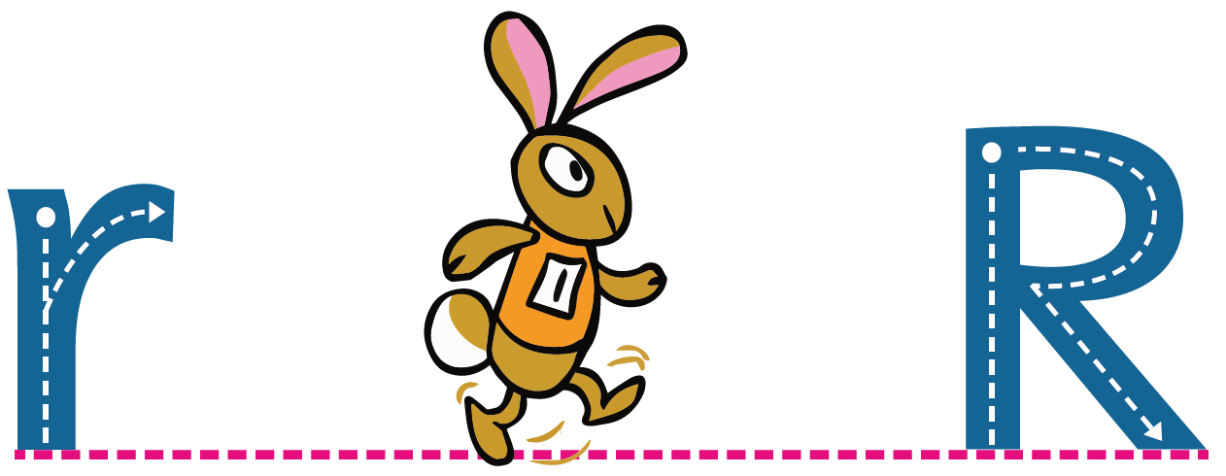
From head to tail then up and
over along his ears.

Slide 19

Left around, right around, from head to tail.

Slide 20
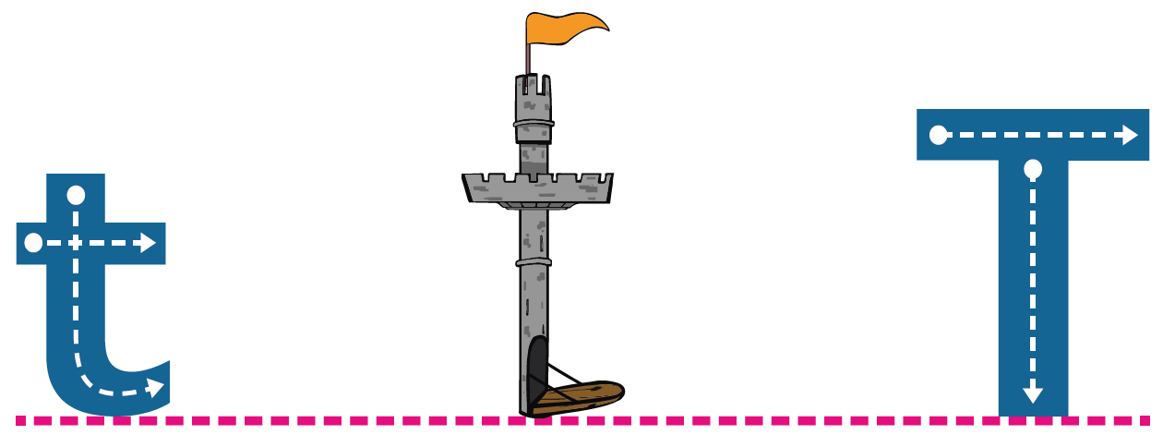
Down the tower, lift and cross.

Slide 21

Under the umbrella, up and down.

Slide 22
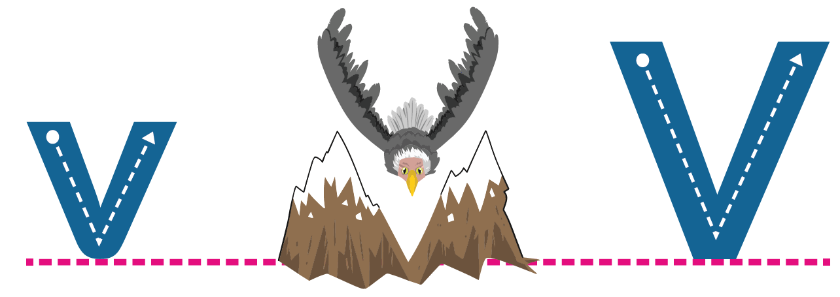
Down one wing and up the other.

Slide 23

Wiggle down, wiggle up, down and up.

Slide 24
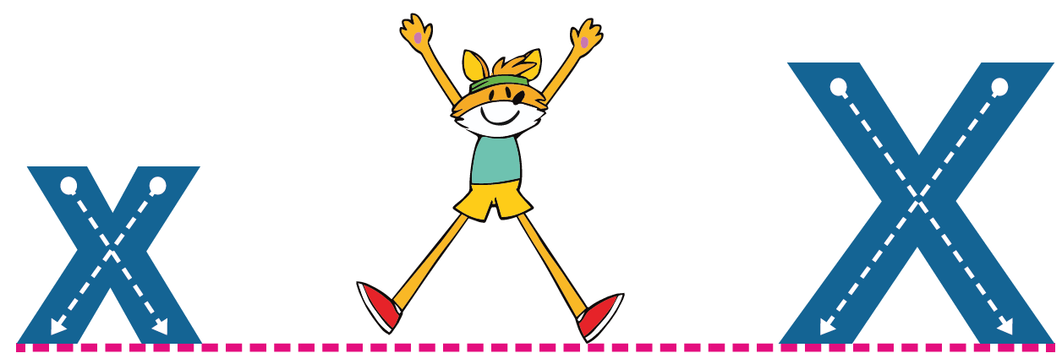
Hand to toe this way, hand to toe that way.

Slide 25
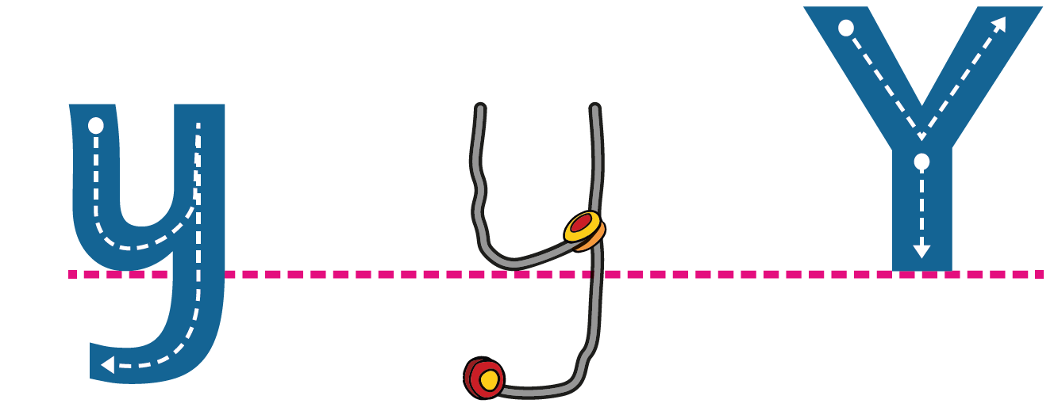
Slant down one string and way down the other.

Slide 26

Zig, zag, zig.

