Slide 1
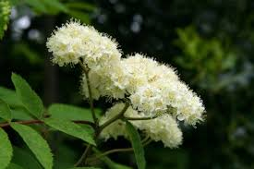
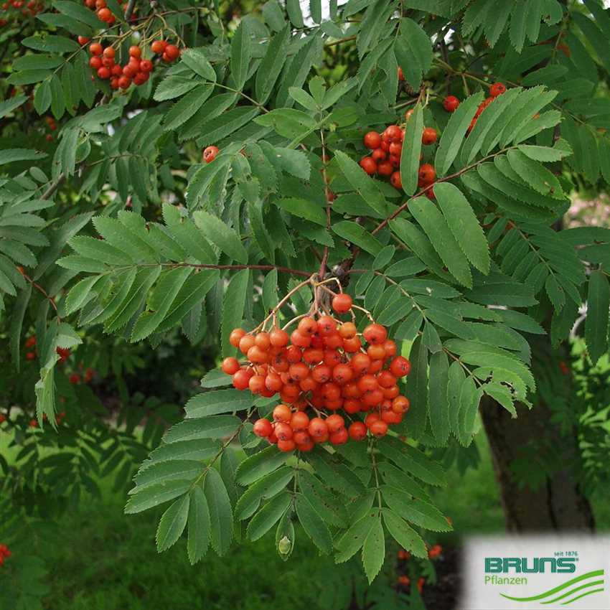
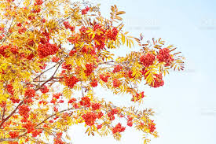
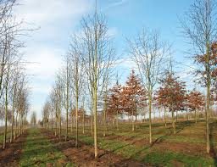
Platinum Jubilee - June 2022
Trees Planted
Sorbus (Rowen or Mountain Ash) - Aucuparia
Spring
Summer
Autumn
Winter
Foundation

Slide 2
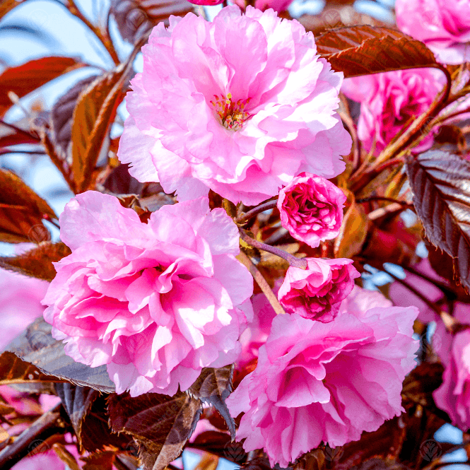
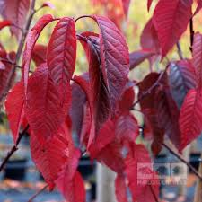
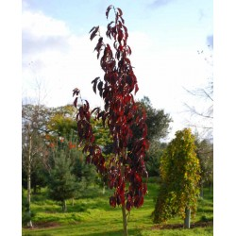
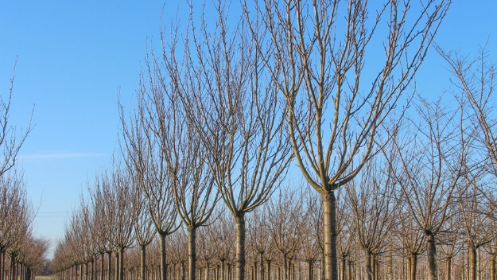
Platinum Jubilee - June 2022
Trees Planted
Prunus (Flowing Cherry) – Royal Burgundy
Spring
Summer
Autumn
Winter
Year One

Slide 3
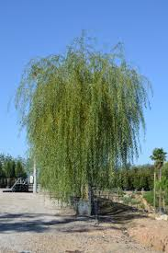
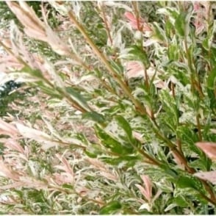
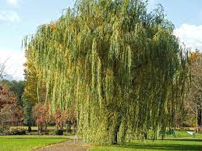
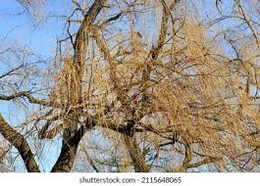
Platinum Jubilee - June 2022
Trees Planted
Salix (Weeping Willow) – Vitellina Pendula
Spring
Summer
Autumn
Winter
Year Two

Slide 4
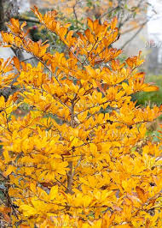
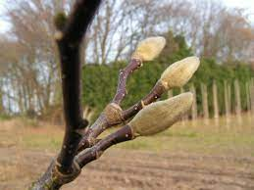
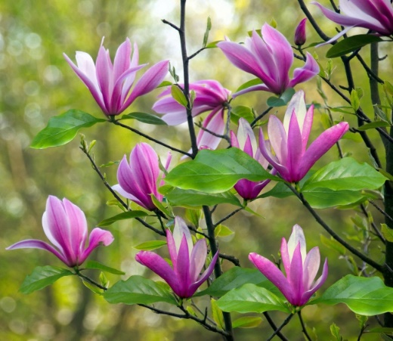
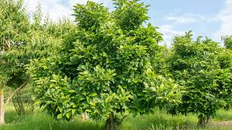
Platinum Jubilee - June 2022
Trees Planted
Magnolia - Susan
Spring
Summer
Autumn
Winter
Year Three

Slide 5
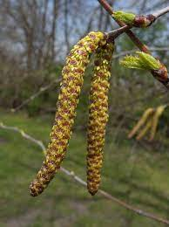
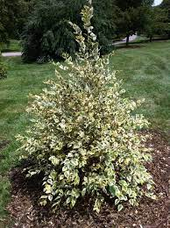
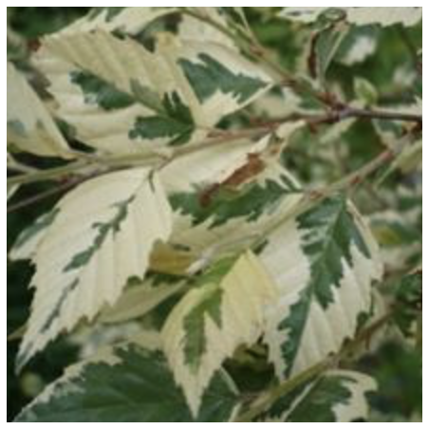
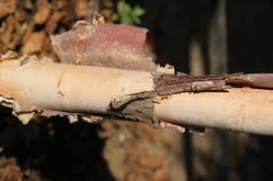
Platinum Jubilee - June 2022
Trees Planted
Betula (Birch) Nig - Shiloh Splash
Spring
Summer
Autumn
Winter
Year Four

Slide 6
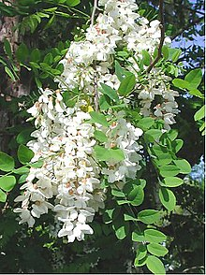
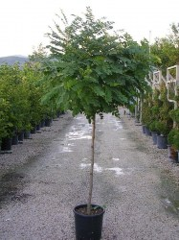
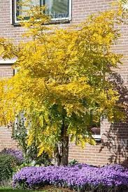
Platinum Jubilee - June 2022
Trees Planted
Robina Pseud - Umbraculifera
Spring
Summer
Autumn
Winter
Year Five

Slide 7
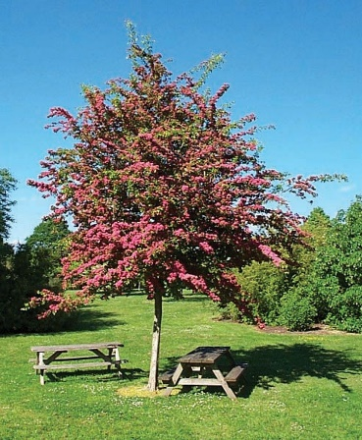
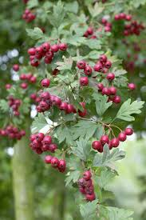
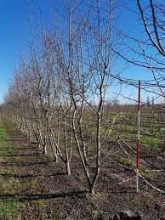
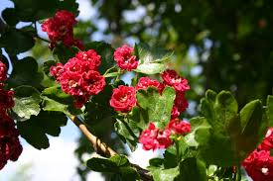
Platinum Jubilee - June 2022
Trees Planted
Crataegus (Hawthorn) - Pauls Scarlet
Spring
Summer
Autumn
Winter
Year Six

