Slide 1


Slide 2
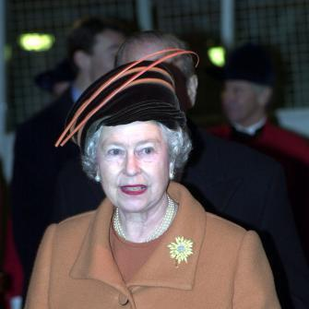
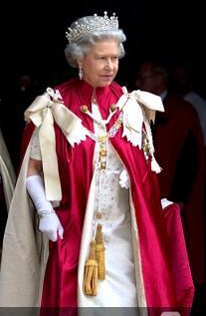
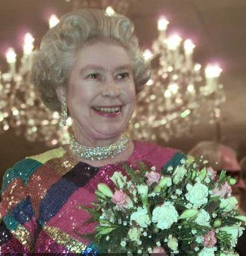
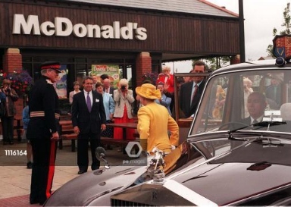
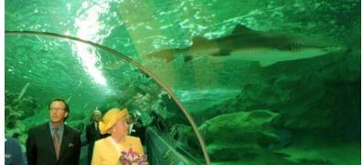
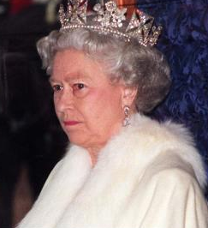
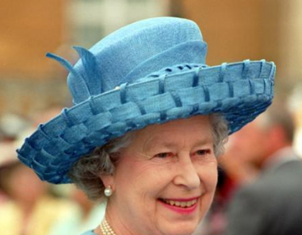
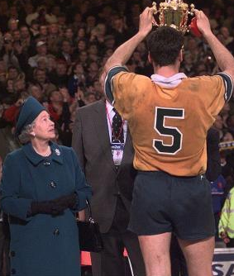
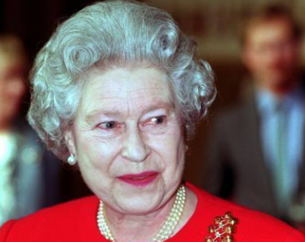
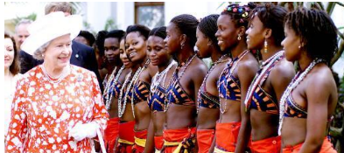
The 1990s by Cedars
Visiting McDonald’s – July 1998
Visiting an aquarium 31st July 1998
Visiting the River Thames 31st December 1999
Visiting Westminster Abbey 13th May 1998
Watching the Royal Variety Show 29th November 1999
Welcoming the newest state to the commonwealth, Mozambique.
November 1999
Hosting her first garden party of the season – July 1998
In her carriage on her way to Buckingham Palace 24th November 1998
Awarding the Victoria Cross 14th April 1999
Presenting the trophy for the Rugby World Cup
November 1999

Slide 3

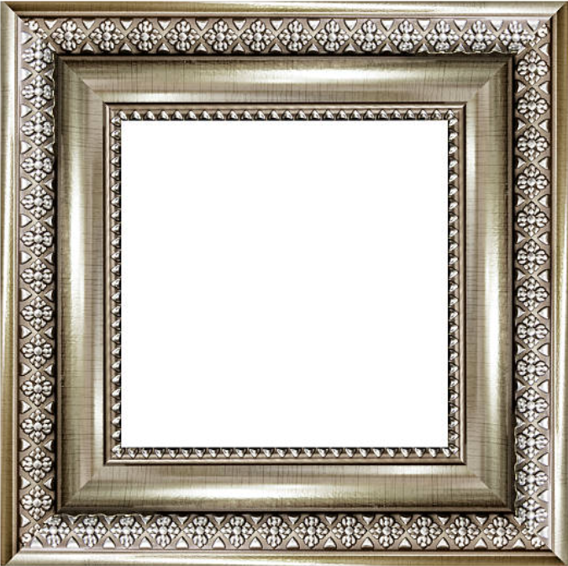

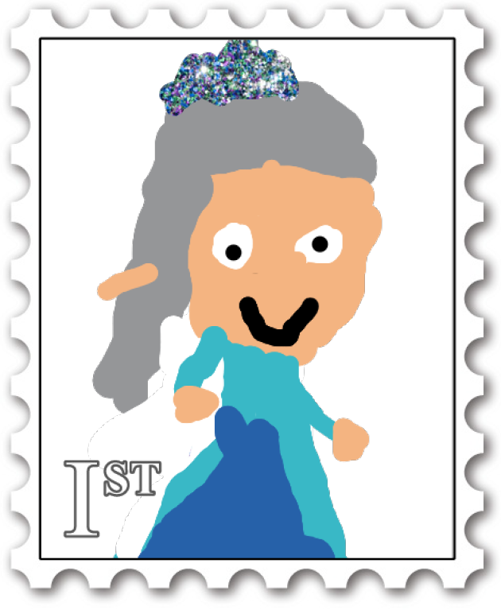
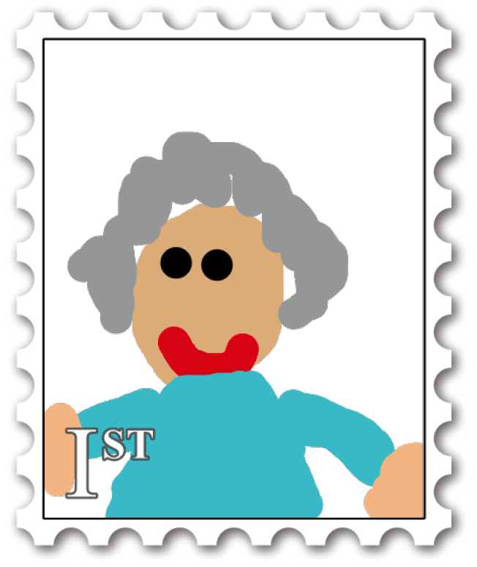
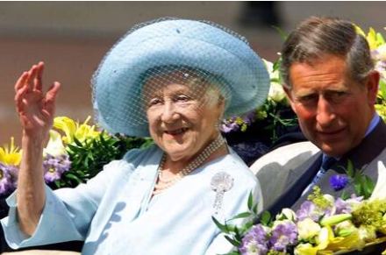
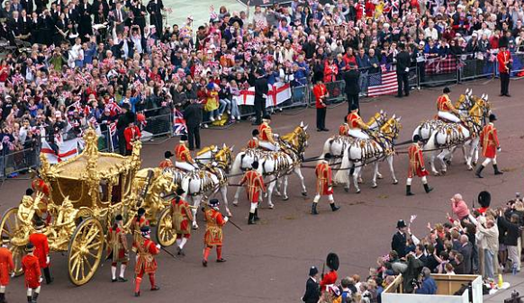
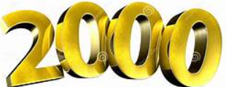
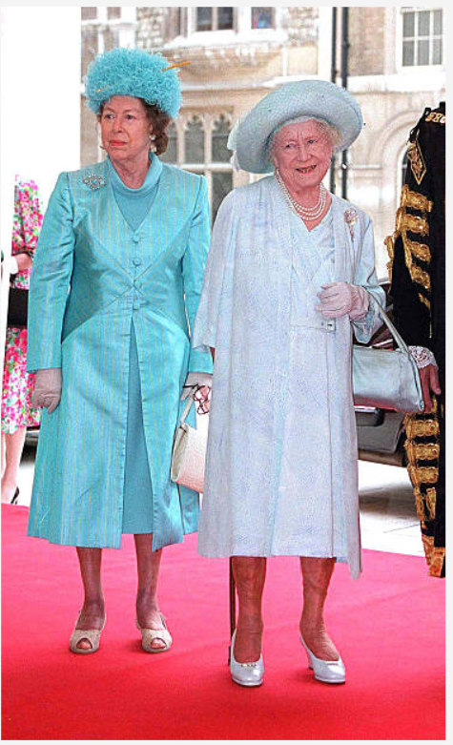

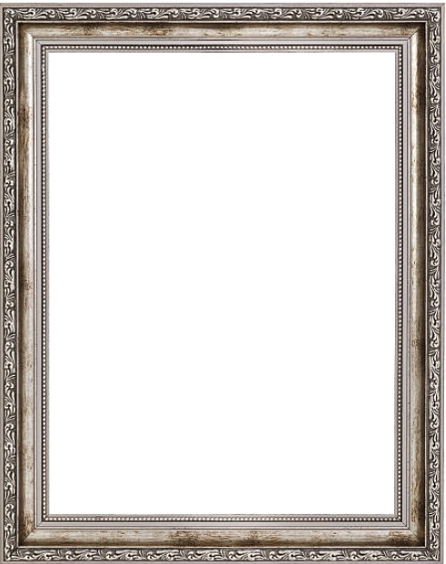
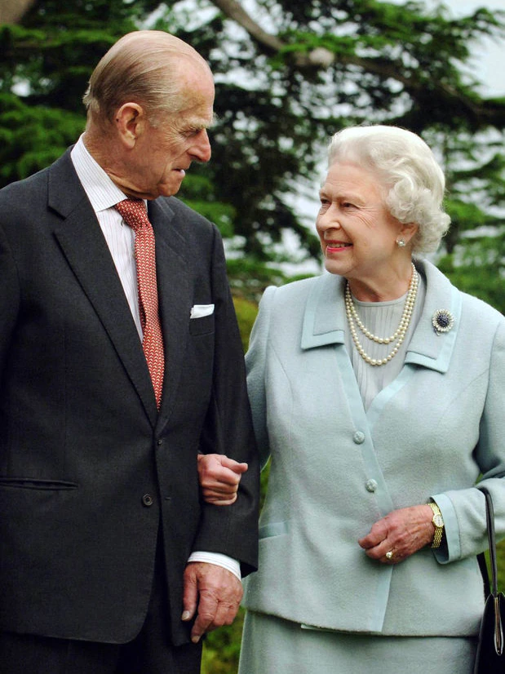
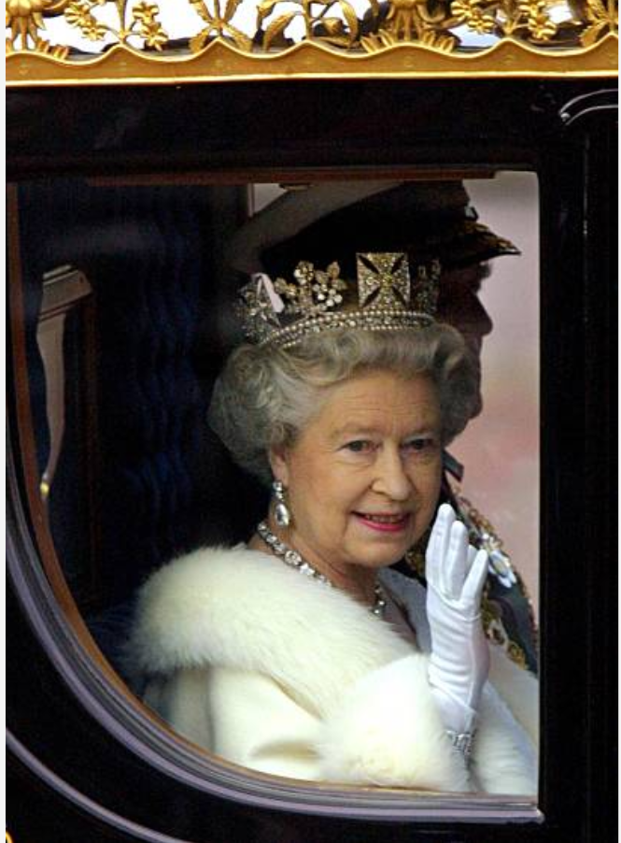

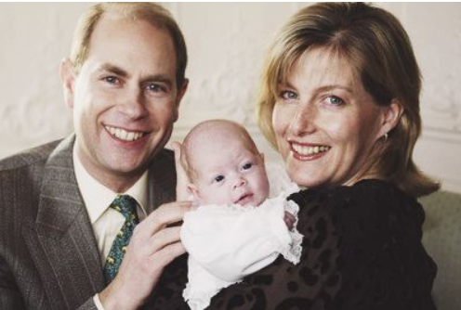
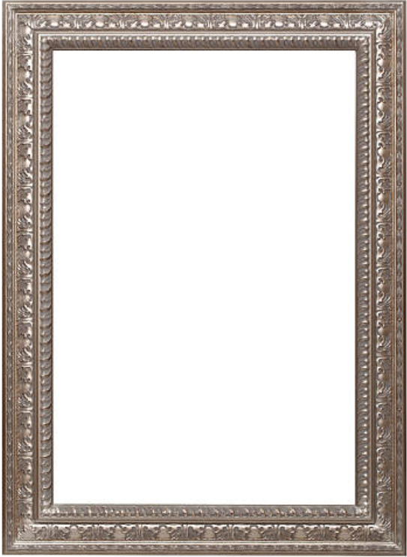
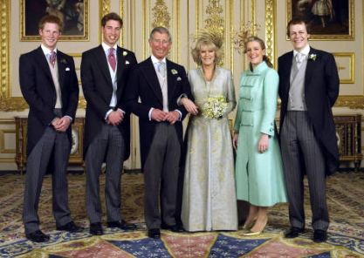
2002
The Golden Jubilee
The 2000’s
by Maples
2000
Queen Elizabeth Celebrated her mums 100th birthday.
2002
This was a difficult year for the Queen. Her sister, Princess Margaret, and her mother died within a month of each other.
2000’s
2003
Her granddaughter - Lady Louise Alice Elizabeth Mary Mountbatten-Windsor is born.
2007
The Queen and The Duke of Edinburgh celebrated their 60th wedding anniversary.
2005
The Queens son, Prince Charles, married Camilla Parker Bowles.
2006
She celebrated her 80th birthday.

Slide 4

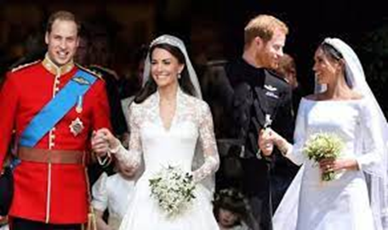
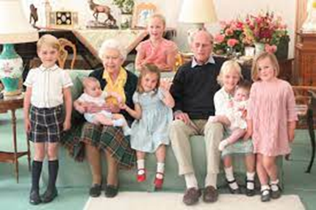
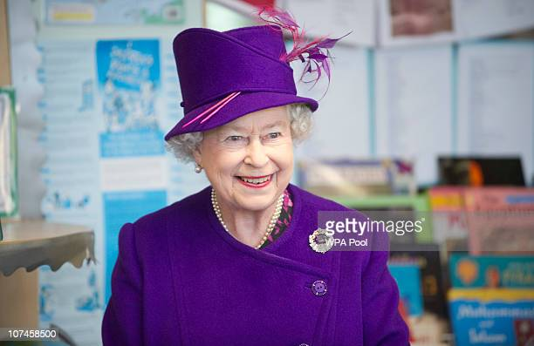
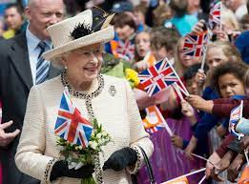
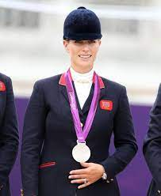
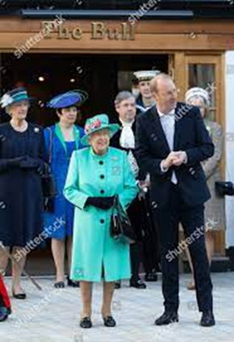
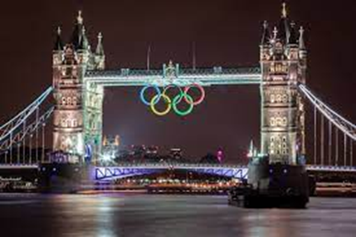
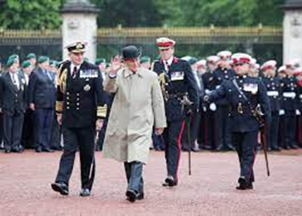
2010 – 2019 In this decade there were the weddings of Prince William and Kate Middleton in 2011 and Prince Harry and Megan Markle in 2018.
Eight of The Queen’s great grandchildren were born, including Prince George in 2013, Princess Charlotte in 2015 and Prince Louis in 2018.
The Queen celebrated her Diamond Jubilee in 2012 and The Olympics were held in London in 2012. The Queen’s granddaughter Zara Philips took part in the Olympics won a silver medal in horse-riding.
Prince Philip retired from royal duties in 2017. The Queen visited a new shopping centre called The Lexicon in Bracknell in 2018. Our head teacher and some children went to The Lexicon to welcome Queen Elizabeth to our town.
Click on the link to see Queen Elizabeth and 007 James Bond arrive to start The 2012 Olympics Opening ceremony
https://www.youtube.com/watch?v=1AS-dCdYZbo
Willows

Slide 5
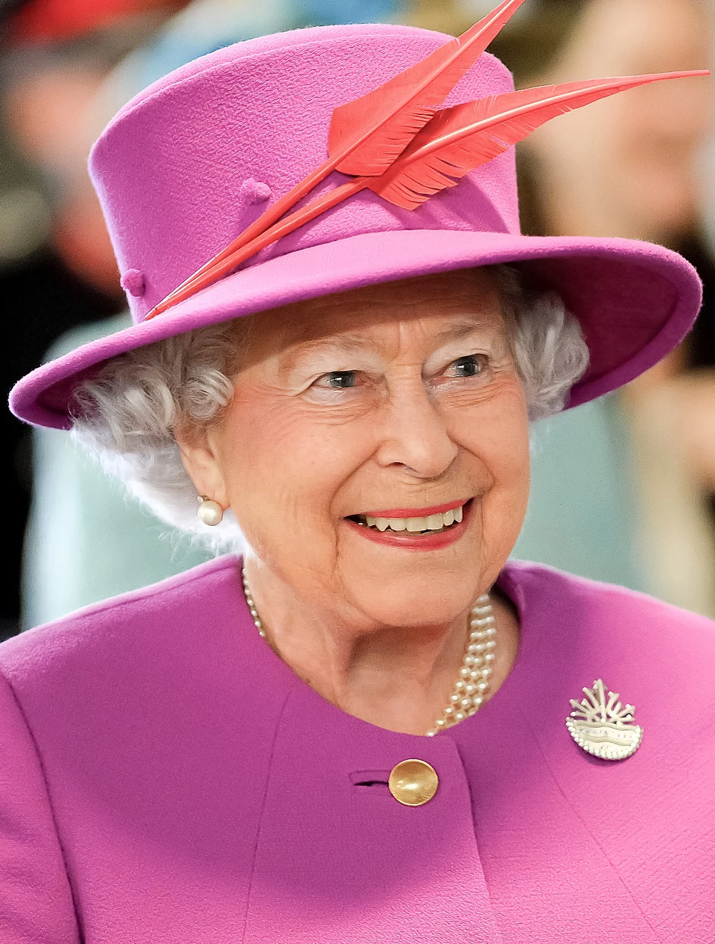
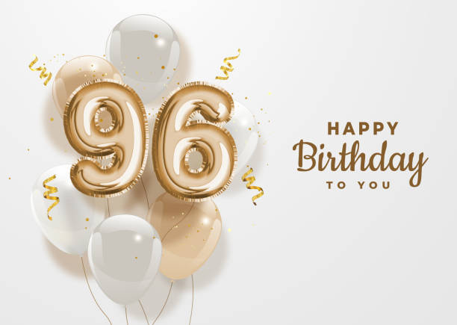
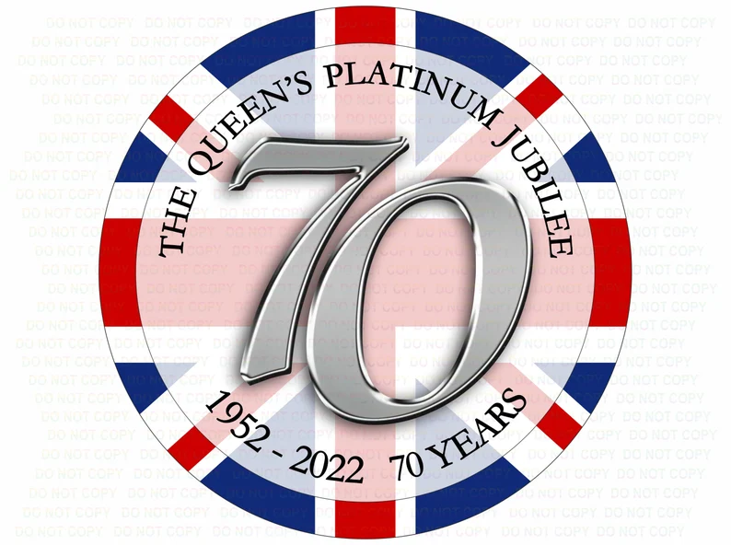
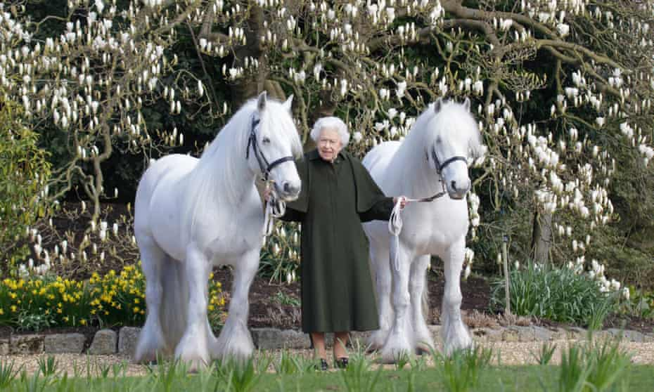
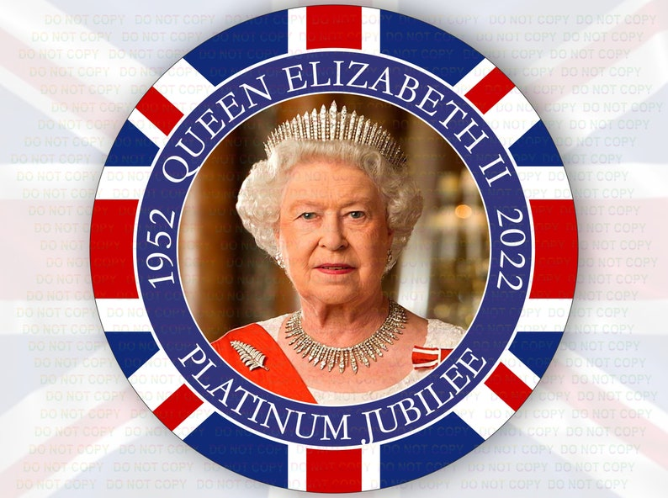
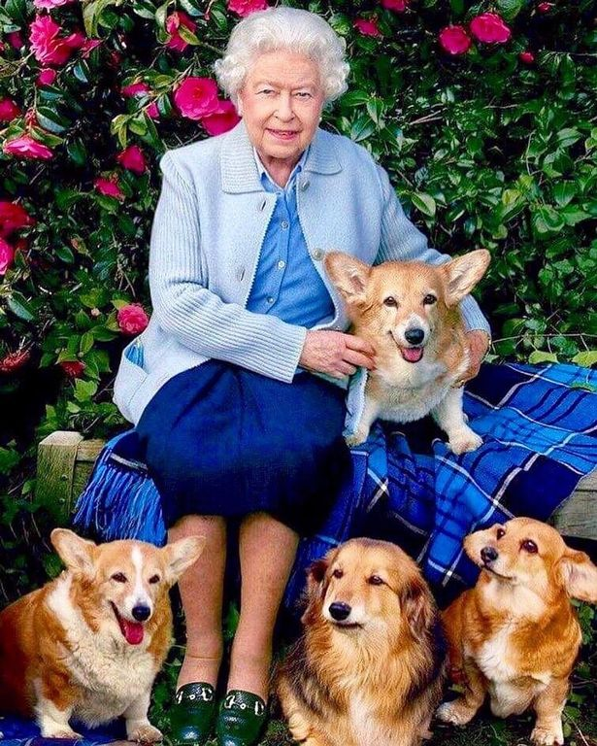
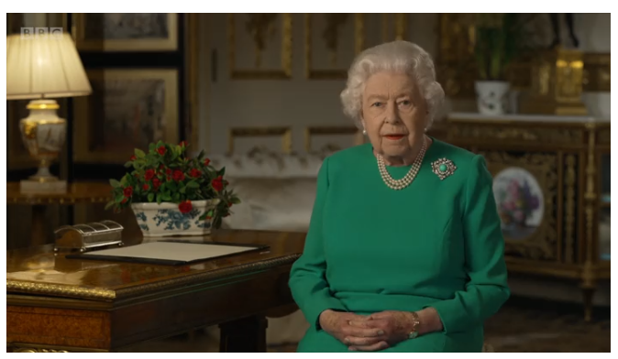
Queen Elizabeth II by the Acorns
2020-Present
The Queen gave a speech about Covid 19. 24 Million people watched it.
Candy the Dorgi
Muick the Corgi & one Corgi who name is unknown
Lissy the Cocker Spaniel

