Slide 1
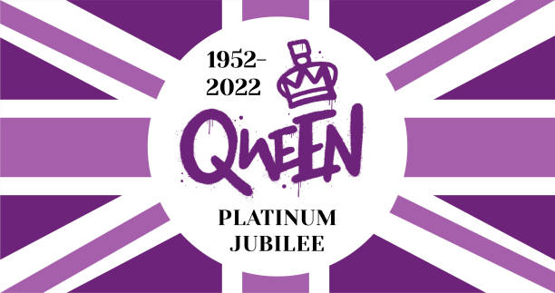

Slide 2
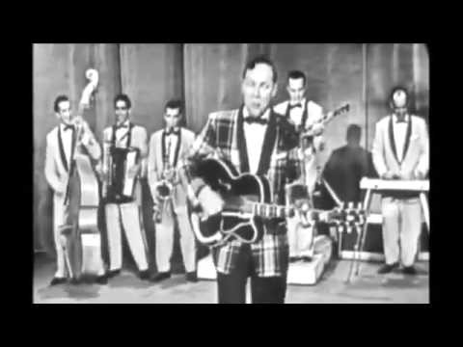
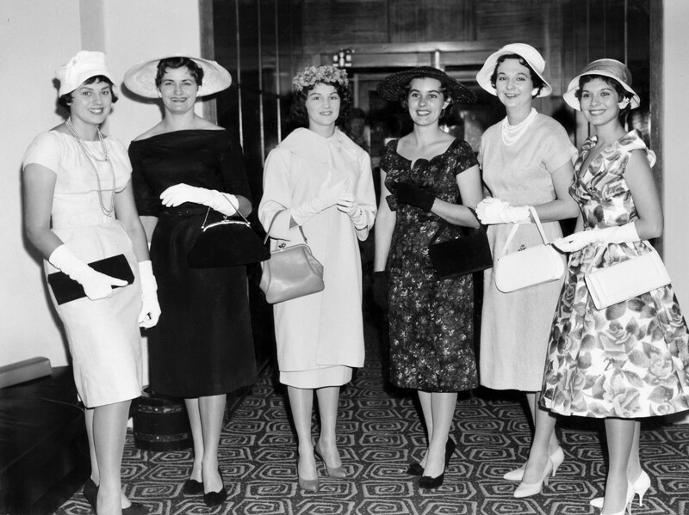
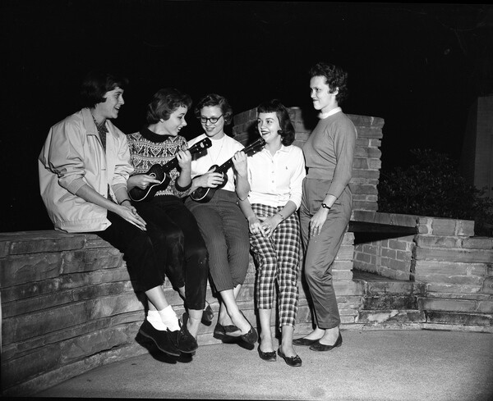
Life in the 1950’s by Year 6
Clothing – Women began to wear trousers. Men still wore suits. Jeans began to be worn. Clothing was more readily available after rationing. Women still wore gloves and hats.
Music – the Rock n roll era was established as well as nostalgic music.
Rationing – this finally ended in 1954

Slide 3
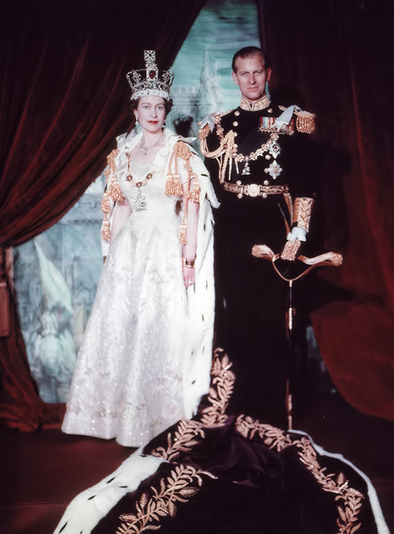
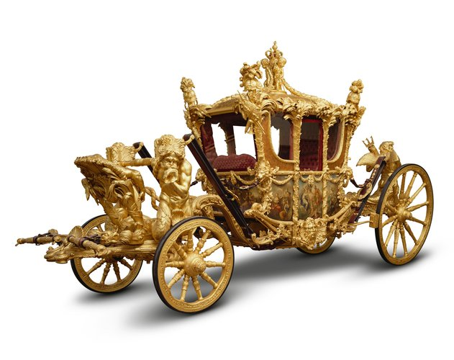
The Coronation
She became Queen on 6th February 1952. She was in Kenya
at the time.
Her coronation was on 2nd June 1953.
The orb, sceptre and crown are part of the Crown Jewels.
There were 8,000 people in Westminster Abbey and the
service lasted 3 hours. It was the first televised coronation.
The State Coach weighs 4 tonnes and needs 8 horses to pull it. It is very uncomfortable!

Slide 4
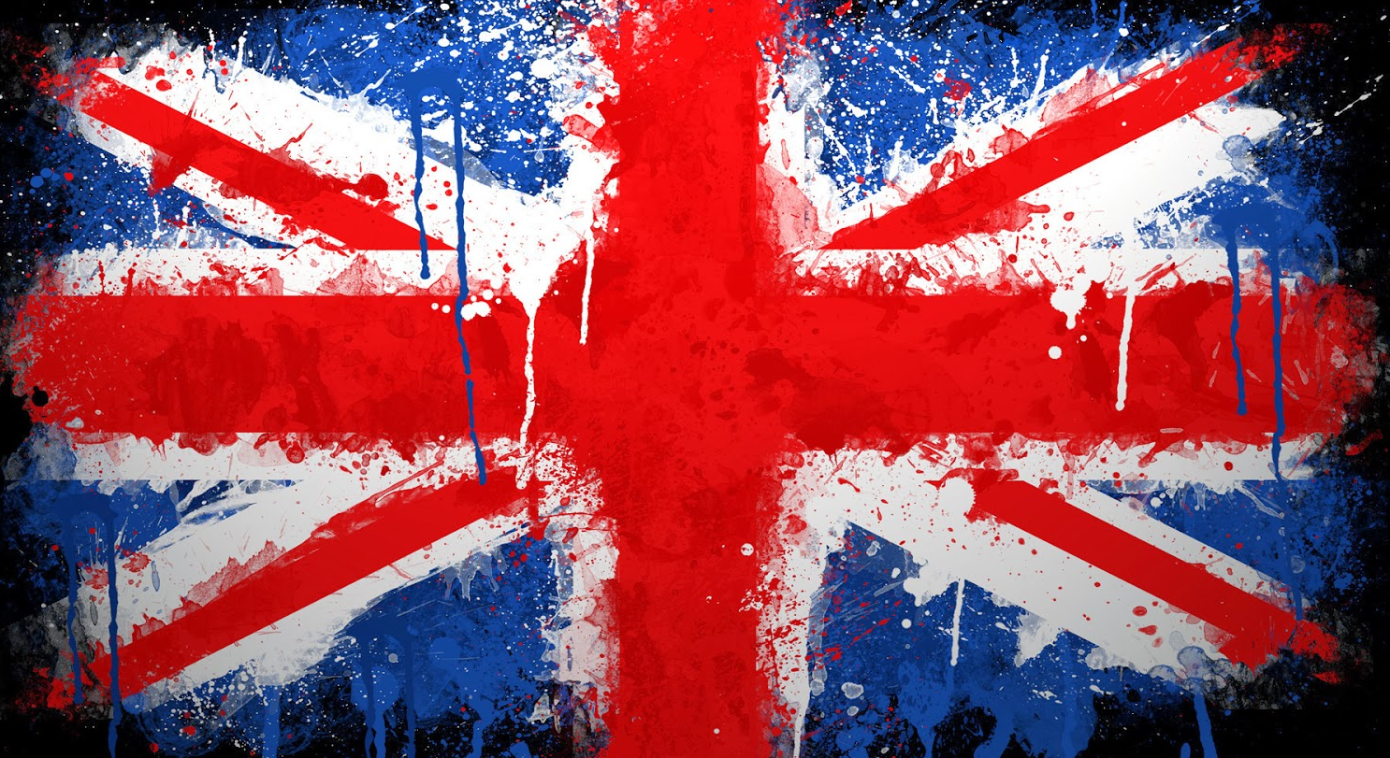
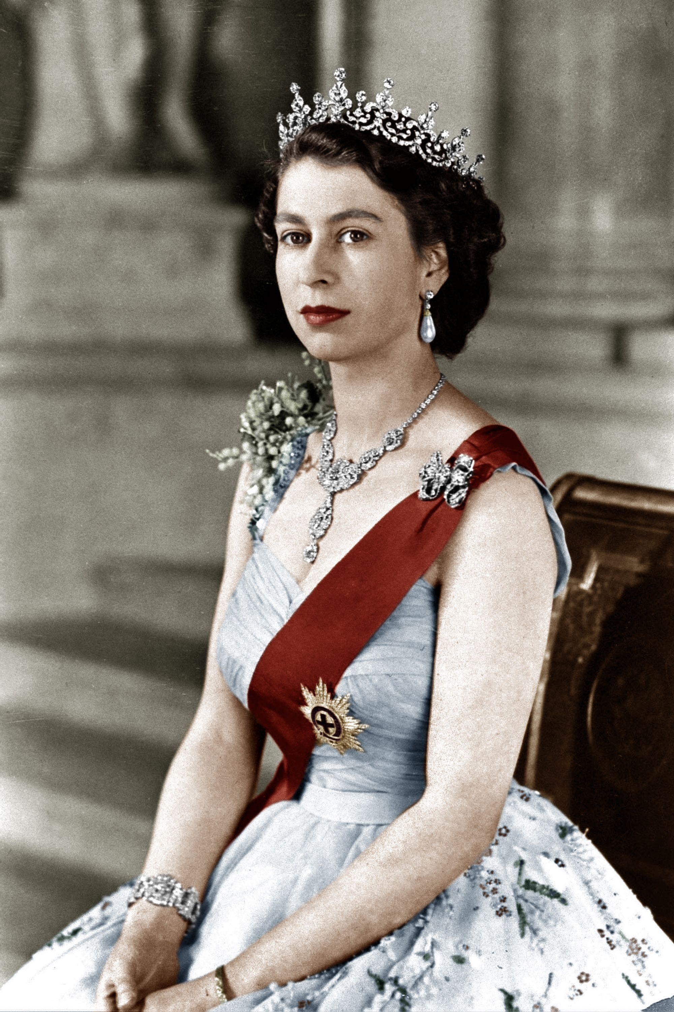
The Queen in the 1960s by Year 5
After her first two children, Queen Elizabeth II waited more than a decade before having more—she was busy being Queen after all. She and Prince Philip welcomed their third child, Prince Andrew, in 1960, and their youngest, Prince Edward, in 1964
How old was the queen in 1960? She was 34 years old.
What events did the queen go through in the 1960s?
Beatle-mania, 1960s.
Decolonisation, 1960s and '70s.
The European Union, 1973.
In 1967 Queen Elizabeth II launched the Cunard cruise liner named after her, the “Queen Elizabeth II” or the “QE2” as is more famously known. She made her maiden voyage travelling to New York on 2nd May 1969.

Slide 5
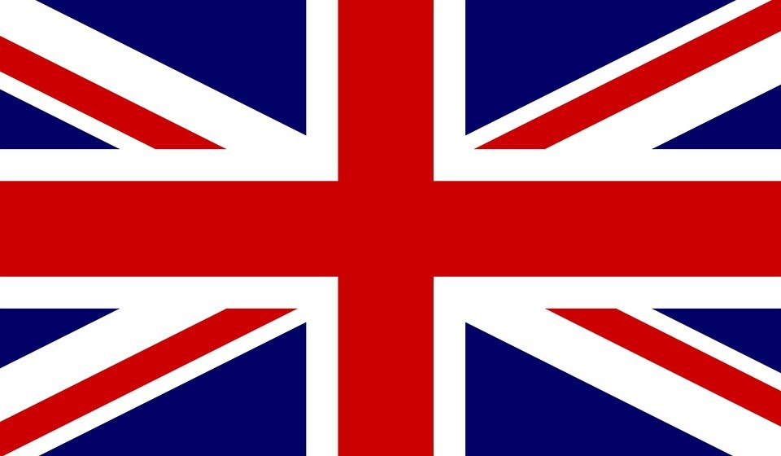
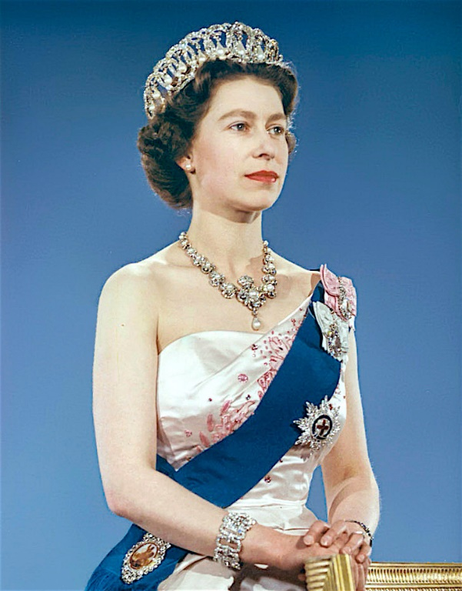
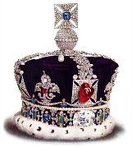
The Queen in the 1960s Year 5
The pop group The Beatles were presented with MBE medals by the queen because in the 1960s POP was the best type of music.
Did you know that the famous moon landing of the Apollo 11 landed on the moon in the 1960s!
The longest-reigning living monarch, Elizabeth became queen in 1952 at the age of 25 following the death of her father, King George VI. Since then, she’s worked with more than 15 prime ministers in her over six decades on the throne, all while carrying out service, engagements, and overseas visits. She’s also shared her royal duties with her late husband of over 73 years, Prince Philip (who passed away on April 9, 2021), their four children, grandchildren, and—in the future—great-grandchildren..

Slide 6
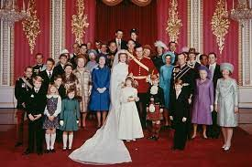
The 70s Year 4
On November 20th 1972 Queen Elizabeth II and Prince Philip celebrated their Silver Wedding Anniversary. The public lined the streets of London as the royal couple took a car ride through the capital, waving to the crowds. There were also street parties around the country, to celebrate the event.
At Westminster Abbey, on 14th November 1973, Princess Anne (the Queen’s only daughter) married British Army cavalry officer Mark Phillips. It was watched by an estimated 500 million people worldwide.

Slide 7
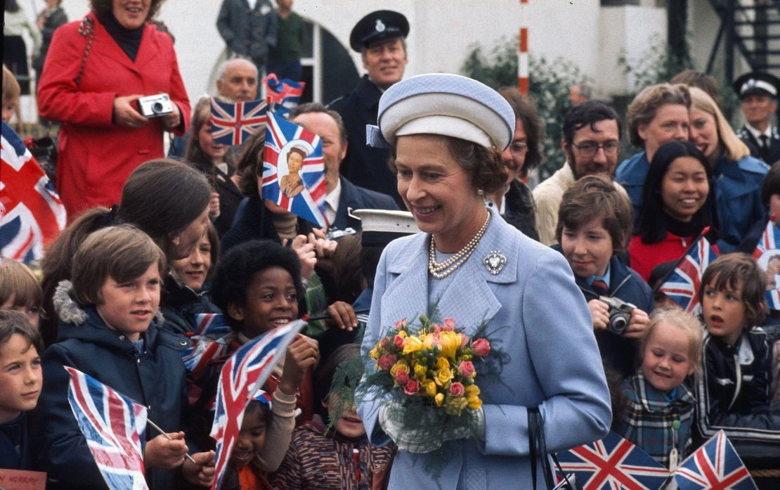
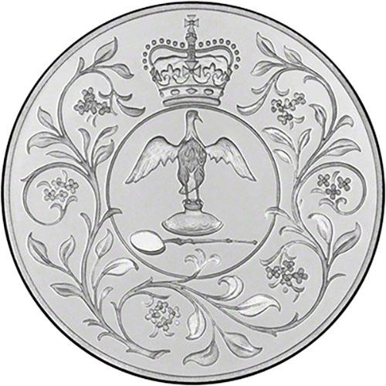
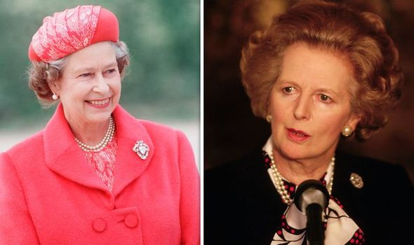
The 70s Year 4
In 1977, Her Majesty Queen Elizabeth II celebrated 25 years on the throne and had her Silver Jubilee. The public lined the streets with more parties. School aged children received a silver coin to remember the jubilee.
On 4th May 1979 Margaret Thatcher became the first female Prime Minister of the United Kingdom. They met together every week for 11 years.

Slide 8
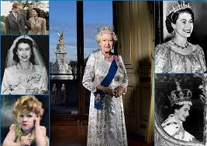
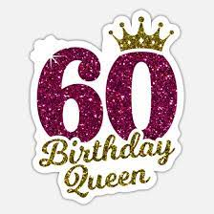
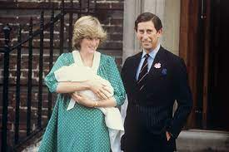
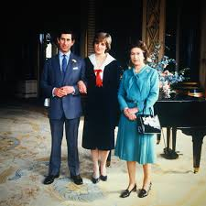
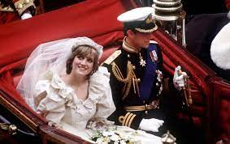
The 80s Year 3
1981 – The Queen’s son, Prince Charles marries Lady Diana Spencer.
1982 – The Queen’s son, Prince Andrew came back safely from the Falklands war.
1982 - Prince William was born in 1982. The first son of Prince Charles.
1986 - The Queen celebrated her sixtieth birthday.

