Slide 1

Mrs Richardson
Teaching Assistants: Mrs Bansal
Welcome to Year 5
Notes:
Include all adult names: Teachers, TA’s, 1:1’s etc.

Slide 2
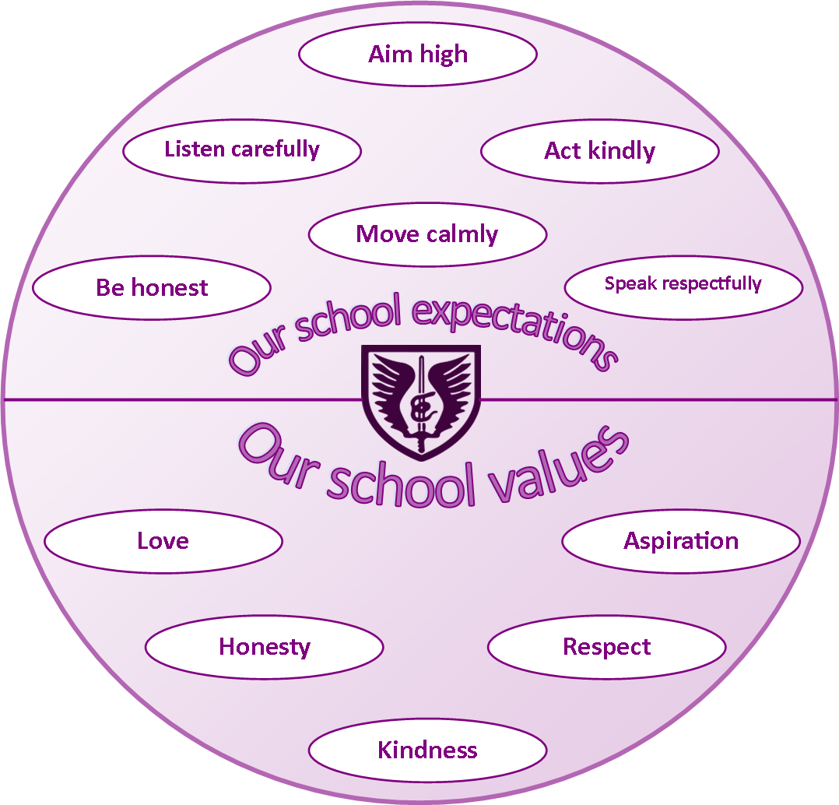
Our school expectations and values
Notes:
Talk about tiered behaviour policy

Slide 3
Year 5 Yearly topic map
 |  | Autumn Term | Spring Term | Summer Term
KS2 | First Half | Autumn 1 Humanities: The Alps (Mountains) Science: Forces | Spring 1 Humanities: Rivers Science: Properties of Materials; Animals including humans | Summer 1 Humanities: Caribbean Science: Reversible and Irreversible changes Reproduction (statutory)
 | Second Half | Autumn 2 Humanities: Ancient Greeks (Legacy) Science: Space and Global Warming | Spring 2 Humanities: WW2 The Battle of Britain Science: Animals including humans; Life Cycles | Summer 2 Humanities: Windrush Science: Reproduction (statutory) Plastic Pollution
 | Topic Links & Extra Curricular
 | Autumn Harvest (donations) Individual Photos Online live lesson (Greeks) Panto Christmas lunch | Spring Swimming Science Week Trip to Eton College Collections Museum (WW2) | Summer Berkshire Music Festival at the Hexagon Class Photos Sports Day Transition Days (x2)
* Field trips and events in school are subject to change. Those listed above are indicative and not guaranteed to take place. As ever, with changing guidance and regulations, activities may be subject to change at short notice.

Slide 4



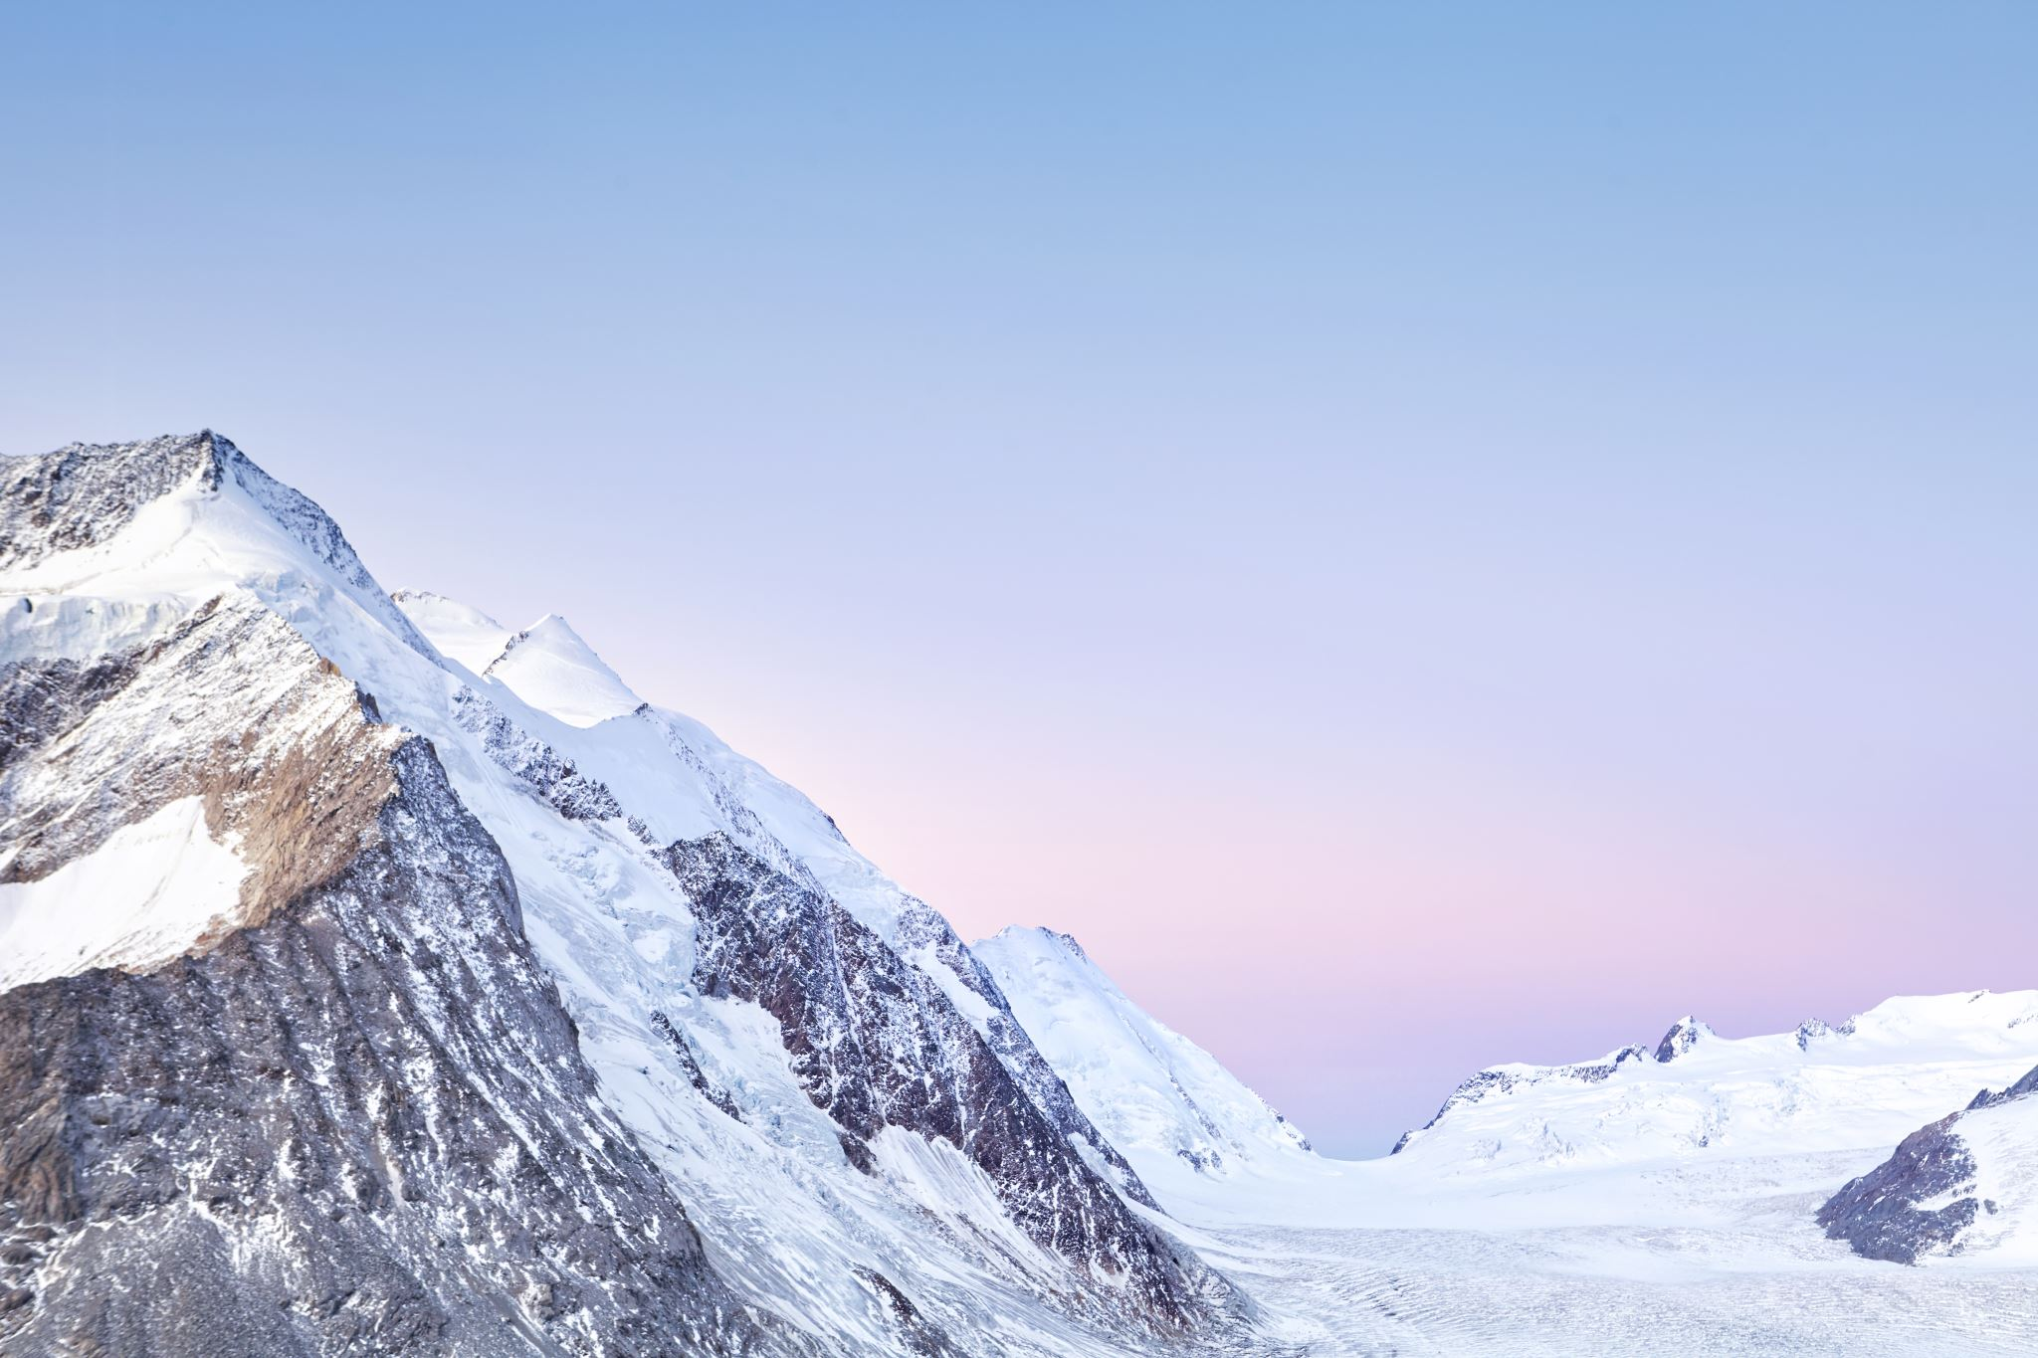
Year 5 Autumn 1 homework grid
Year 5 Autumn Term 1 – Topic: The Alps (Mountains)
What is an avalanche? Find out what they are an how they happen. Think of a creative way to present your findings. | Write a fact file about The Alps. Include subheadings to separate the information. | Imagine you are going to climb a mountain. Research, draw and label the equipment and clothing you would take with you, | Write a rap or poem giving advice on how to respect mountain environments. | Using any media (paint, pastels, junk modelling, etc.) create a realistic mountain scene. | Make a model of a mountain. Ensure it is 3D and includes the layers/biomes of the mountain.
Write an acrostic poem about a mountain in The Alps. | Use a map to locate different ski resorts around the world, in particular those located in The Alps. | Create a warning poster about the dangers of climbing Mount Blanc. | Create a brochure to advertise a ski resort. Include sections on all the things which can be found there. Remember to be persuasive. | Write a mythical yeti story, including your own fantasy characters. Describe the setting using a range of adjectives. | Create a meal plan for a mountain climber. Think of what would give the most energy, the equipment they might have available and how to keep the food safe to eat.
Come up with your own project ideas too! | Daily Reading | Please record your child’s reading in their reading record.

Slide 5
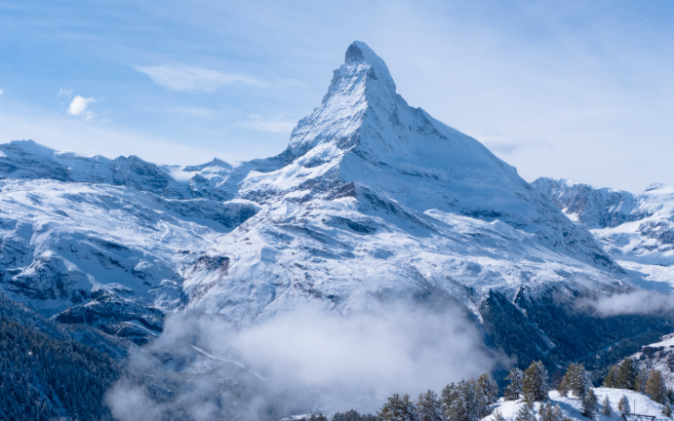
Year 5 Autumn 1 topic map
English Our writing will include a narrative set from the POV of a mountain climber, and creating a set of instructions to support someone planning to climb a mountain. We are reading Who Let the Gods Out? By Maz Evans during our Whole Class Guided Reading Sessions. | Geography We will explore what life is like in The Alps and investigate tourism in mountain environments. We will learn about the climate and features of The Alps, with a particular focus on Innsbruck. | Music We will be moving over to Kapow for our music scheme and curriculum. Our first unit focuses on ‘Music in Nature: chords and melodies’. | RE Our topic is How do Rites of Passage shape the lives of different Christians? We will focus on baptism as a Christian rite of passage, while also discussing other rites of passage which people of the Christian faith, other faiths or no faith might experience.
Maths We will start Year 5 with a focus on Number and Place Value, including Roman numerals. We will also begin work on the four operations (addition, subtraction, multiplication and division). The multiplication tables, which the children worked so hard on in Year 4, continue to be important and we still encourage regular TTRS practise at home. | PSHE Our first topic is My Healthy Self. This focuses on discussions around supporting our minds and bodies as we grow. We will also learn about recognising and coping with strong, complex feelings. | The Alps (Mountains) | Computing The children will investigate computer systems – inputs, processes and outputs – in the context of common technology such as washing machines, online shopping and traffic lights.
Spellings We complete daily spellings tests, using the Spelling Shed list for that week. Children should practise their spelling words on paper, on the website, or both. | Science Our first topic in Science is Forces. We will talk about gravity, friction and air resistance. We will then develop this Physics focus with a topic of Earth and Space. | French Our first unit is ‘French monster pets’. This is fun way of introducing and reinforcing French adjectives and nouns, considering how these may change depending on gender. | Class Reading Book At the end of each day, we will read from Katherine Rundell’s The Wolf Wilder. This book will be read for pleasure and has been chosen because it is a high-quality text with a broad range of high-level vocabulary.
Notes:
Clip a picture of topic map from website

Slide 6
Year 5 typical timetable
Monday | Tuesday | Wednesday | Thursday | Friday
Morning Task | Morning Task | Morning Task | Morning Task | Morning Task
Heads Worship | Singing Assembly | Wednesday Worship | Class Worship | Celebration Worship
Handwriting English | Handwriting English | Handwriting English | Handwriting English | Handwriting English
Guided Reading | Guided Reading | Guided Reading | Guided Reading | Guided Reading
Break | Break | Break | Break | Break
Maths | Maths | Maths | Maths | Maths
Lunch | Lunch | Lunch | Lunch | Lunch
Quiet (Independent) Reading | Quiet (Independent) Reading | Quiet (Independent) Reading | Quiet (Independent) Reading | Quiet (Independent) Reading
Spelling Lesson | Spelling Lesson | Spelling Lesson | Spelling Lesson | Spelling Lesson
RE | French | Humanities | Science | PE
 | Library Time
PSHE | Music | Art / DT | ICT | PE
Class text | Class text | Class text | Class text | Class text

Slide 7
Mobile phones & Walking home
Pupils are permitted to bring mobile phones to school once a permission slip is completed.
Phones must be handed in as soon as your child enters the classroom each morning.
Phones will be stored in a locked cupboard inside the classroom for the duration of the school day.
Pupils are permitted to walk home at the end of the day once a permission slip is completed.
Slips available from the office.

Slide 8
How to help at home
Make sure your children arrive at school: on time [doors open at 8:40am], well rested, fed and ready for a day of learning.
Encourage/reinforce the learning of number bonds and times tables and use real life examples to support this, for example when shopping or preparing meals.
Support your children with their home learning through regular practice and encouraging them to take the lead. Also follow your child’s interests.
Take time to play and relax with your children. We work them hard during the day and time to play and be together is one of most invaluable learning opportunities you can provide.

Slide 9

KS2
How to help with reading at home
Read to and with your child. Encourage a love of reading and create spaces for children to enjoy reading, sharing and comparing books.
Listen to your child read often, particularly supporting in decoding unknown words, understanding new vocabulary and summarising what they have read.
This is really important throughout a child’s primary education, even when they are able to read independently.
Ask questions using the VIPERS technique to check understanding.
When working on sight vocabulary, flash cards are very useful.
Please update your child’s reading record at least weekly.
Do not forget the power of reading to your child!

Slide 10
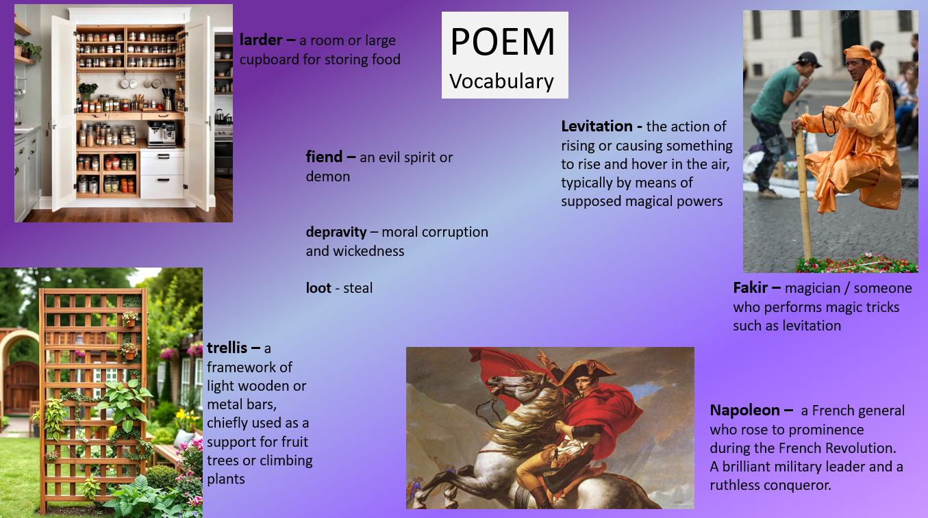
KS2
How to help with reading at home
Notes:
EYFS and KS1 to add more detail re FFT Phonics and books

Slide 11


KS2
TTRS, Numbots and Spelling Shed
Last year, we had a focus on times tables, culminating the Year 4 Multiplication Tables Check. This year, we will continue to encourage regular practise of times tables, as they are fundamental to many areas of Maths.
Each pupil has a login for Times Tables Rockstars (and Numbots), please ask if it has been forgotten so we can give a reminder.
Spellings are set weekly and these can be accessed through the Spelling Shed website, or on the school website.
Please ask if you need a login reminder.

Slide 12
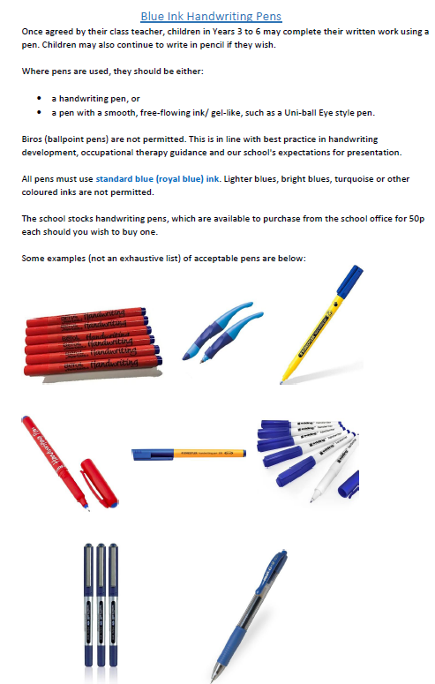
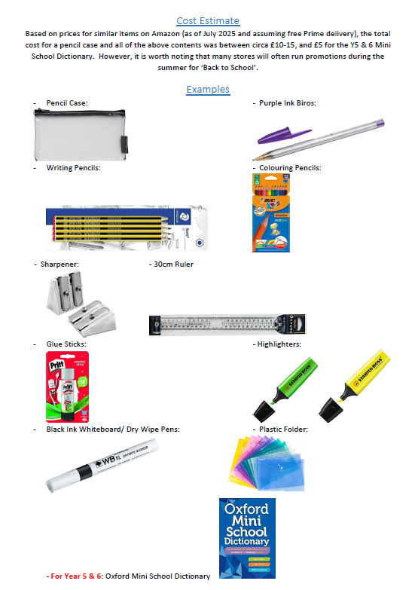
General Information, Equipment and Resources
•Ensure that children have the appropriate school uniform for the day and weather.
•Water bottles daily. No fizzy or energy drinks. Juice is discouraged.
•Bags – Only small bags are needed and should fit comfortably inside the provided lockers, along with PE bags.
*No bulky keyrings attached to bags
Notes:
Also talk about other resources such as: Numicon, Multilink, iPads/ Laptops with games, cut up sentences, magnetic letters, Bead Strings, Coins, Deines

Slide 13
Other Information
Snack time – should be a healthy snack/ fruit only.
Please be mindful of the quantity/ volume of food and allergies.
We are a nut-free school - please check ingredients lists and avoid all chocolate.
Please ensure you have updated the office with up to date medical details, allergies, dietary requirements details and in-date medication.
Attendance at school is of critical importance – there is a direct correlation between school attendance and pupil achievement.

Slide 14
How to contact us ☺
Please contact the school office either in person, by telephone or email.
All messages for teachers and SENCO should be sent to the secretary email address below.
Please give a short context to the request - this can help us plan out time to contact you.
Newsletter every Friday by email (do check Spam/Junk folders)
Website – All information there. Please take a look at class pages, policies pages, the 'Parent Info' sections and the Home School Agreement.
01344 420878 / secretary@stmicheast.co.uk

Slide 15
Any questions?
Thank you
☺

