Slide 1

Year 6 SATs 2027 Presentation for Parents, Carers & Guardians

Slide 2
What are SATs?
SATs are the Standardised Assessment Tests that are given to children at the end of Key Stage 2.
The SATs take place over four days, starting on Monday 10th May ending on Thursday 13th May.
The SATs papers consist of:
  Grammar, punctuation and spelling (paper 1: GPS) – Monday 10th May
  Grammar, punctuation and spelling (paper 2: Spelling) – Monday 10th May
  Reading – Tuesday 11th May
  Maths (paper 1: Arithmetic) – Wednesday 12th May
  Maths (paper 2: Reasoning) – Wednesday 12th May
  Maths (paper 3: Reasoning) – Thursday 13th May
Writing is assessed using evidence collected throughout Year 6. There is no Year 6 SATs writing test.
The key stage 2 tests will be taken on set dates unless your child is absent, in which case they may be able to take them up to 5 school days afterwards.
Notes:
Dates confirmed by the Standards and Testing Agency for 2027: Monday 10 May to Thursday 13 May 2027.
Nothing changes about the papers themselves for 2027. Parents may see news coverage about changes to primary assessment: following the Curriculum and Assessment Review, the government has said the Standards and Testing Agency will review the grammar, punctuation and spelling test and improve how writing is assessed at the end of key stage 2. A revised national curriculum is due to be published in 2027 for first teaching in 2028, so this year’s Year 6 will be among the last to sit SATs based wholly on the current curriculum.

Slide 3
When and how SATs are completed
The tests take place during normal school hours, under exam conditions.
Children are not allowed to talk to each other from the moment the assessments are handed out until they are collected at the end of the test.
After the tests are completed, the papers are sent away to be marked externally.
The results are then sent to schools on Tuesday 6 July 2027.
Each test lasts no longer than 60 minutes:
  Grammar, punctuation and spelling (paper 1: GPS) – 45 minutes
  Grammar, punctuation and spelling (paper 2: Spelling) – 15 minutes
  Reading – 60 minutes
  Maths (paper 1: Arithmetic) – 30 minutes
  Maths (paper 2: Reasoning) – 40 minutes
  Maths (paper 3: Reasoning) – 40 minutes

Slide 4
Specific arrangements for SATs
Children with additional needs (who have similar support as part of day-to-day learning in school) may be allotted specific arrangements, including:
Additional (extra) time;
Tests being opened early to be modified;
An adult to scribe (write) for them;
Using word processors independently;
An adult to read for them (including a translator);
The use of prompts or rest breaks;
Arrangements for children who are ill or injured at the time of the tests.
Pupils with an EHCP are automatically allowed up to 25% additional time (except for the spelling paper, which is not strictly timed). Pupils who use the modified large print or braille versions of the tests are automatically allowed up to 100% additional time.
Notes:
The DfE Key Stage 2 access arrangements guidance (https://www.gov.uk/government/publications/key-stage-2-tests-access-arrangements) gives more details on this, including which arrangements need prior permission.
It should be noted that there are cases when pupils can have access to multiple arrangements (e.g. addition time and a scribe). These are detailed in the above document.
Also note, any pupil can ask for a question to be read to them, though not explained to them. In mathematics, words and numbers may be read but mathematical symbols cannot be read.

Slide 5
SATs results
Tests are marked externally. Once marked, the tests will be given the following scores:
A raw score (total number of marks achieved for each paper);
A scaled score (see below);
A judgement on whether the National Standard has been met.
After marking each test, the external marker will convert the raw score to a scaled score. Even though the tests are made to the same standard each year, the questions must be different. This means the difficulty of the tests may vary. Scaled scores ensure an accurate comparison of performance over time.
Scaled scores range from 80 to 120.
A scaled score of 100 or more shows the pupil is meeting the National Standard.
Notes:
There is no separate test that would indicate a pupil is working above the national standard. Nationally, a scaled score of 110 or more is reported as a high score.
A scaled score below 100 would indicate a pupil is working below the national standard.
To have a scaled score, pupils must have a minimum raw score (determined each year). If the pupil does not achieve the minimum raw score, they have not demonstrated sufficient understanding of the KS2 curriculum in the subject.
The raw score needed to reach 100 changes each year depending on how hard the paper was. In 2026, pupils needed 25 out of 50 in reading (28 in 2025), 56 out of 110 in maths (58 in 2025) and 34 out of 70 in grammar, punctuation and spelling (35 in 2025).

Slide 6
What happens with the results?
When will we find out?
Schools receive results on Tuesday 6 July 2027. You will receive your child’s results before the end of the summer term.
What will the results show?
A scaled score for reading, maths and grammar, punctuation and spelling, and whether your child met the expected standard (a scaled score of 100 or more). Writing and science are assessed by your child’s teacher.
Where do the results go?
Your child’s secondary school receives their results, which helps teachers plan the right support from Year 7.
Do SATs affect secondary school places?
No. Secondary school places are offered in March, before the tests take place.

Slide 7
How did children do nationally in the 2026 SATs?
The percentage of Year 6 pupils in England meeting the expected standard in 2026:
75%
Reading
75%
Maths
74%
Grammar, punctuation and spelling
73%
Writing (teacher assessment)
63%
Reading, writing and maths combined
Just under two in three children met the expected standard in all three of reading, writing and maths. It is common for a child to meet the standard in one subject and still be working towards it in another.
Source: Department for Education, key stage 2 attainment 2026 (provisional), published July 2026.

Slide 8
Grammar, Punctuation and Spelling: Monday 10th May
Grammar, punctuation and spelling consists of two papers.
Paper 1 focuses on all three elements (grammar, punctuation and spelling or GPS). The paper lasts for 45 minutes.
Paper 2 consists of a spelling test only. It should take approximately 15 minutes, although this is not a set amount of time (pupils should be given as much time as they need to complete the test).

Slide 9
Grammar, Punctuation and Spelling: Paper 1 (GPS)
The children will have been working hard with their class teacher on developing and securing their knowledge of the technical vocabulary needed in this test.
This test focuses on:
Grammatical terms/ word classes;
Functions of sentences;
Combining words, phrases and clauses;
Verb forms, tenses and consistency;
Punctuation;
Vocabulary;
Standard English and formality.
This test requires a range of answer types but does not require longer formal answers.
Notes:
The question types include:
Circling
Drawing lines to connect
Multiple choice questions (including ticking tables)
One-word answers
Short answer questions

Slide 10
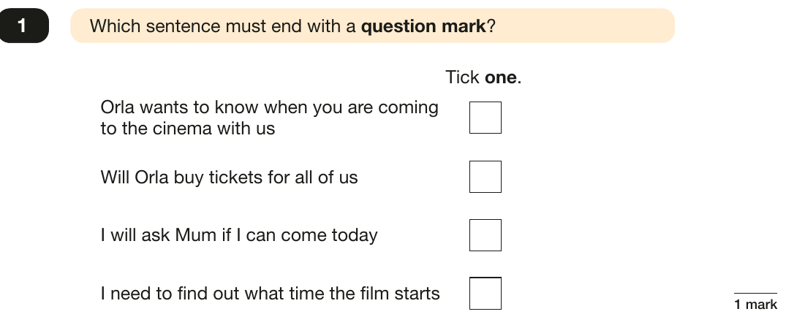
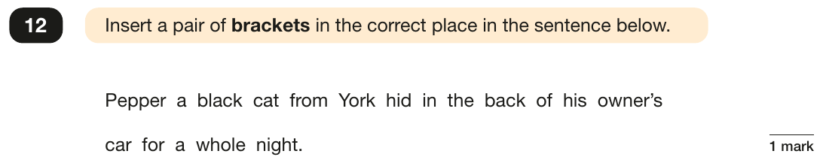
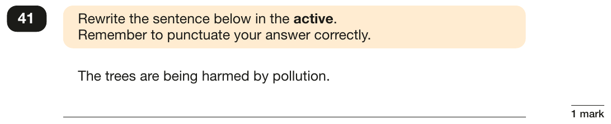
Grammar, Punctuation and Spelling: Paper 1 (GPS)
Example questions:
Answer
Pepper (a black cat from York) hid in the back of his owner’s car for a whole night.
Answer
Will Orla buy tickets for all of us ✓
Answer
Pollution is harming the trees. (“Pollution harms the trees.” is also accepted.)
Notes:
Questions are from the 2026 grammar, punctuation and spelling paper 1 (questions 1, 12 and 41).
For question 41, the mark scheme accepts “Pollution is harming the trees.” or “Pollution harms the trees.” Misspellings of verb forms and errors in punctuation or capitalisation are not accepted.

Slide 11
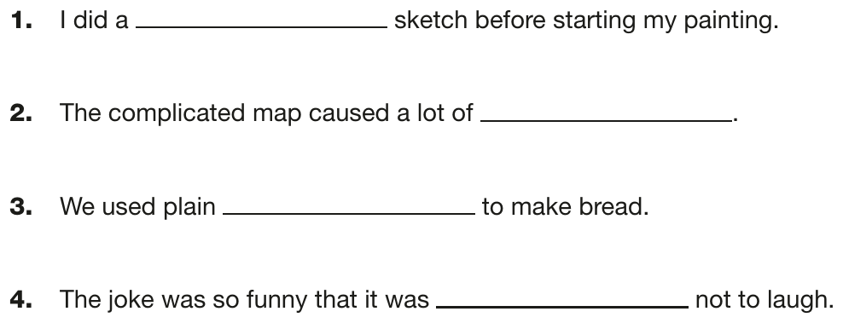
Grammar, Punctuation and Spelling: Paper 2 (spelling)
Paper 2 is a shorter paper that focuses solely on spellings.
Example questions:
2026 spelling script (read aloud by the teacher)
Spelling 1: The word is rough.
I did a rough sketch before starting my painting.
The word is rough.
Spelling 2: The word is confusion.
The complicated map caused a lot of confusion.
The word is confusion.
Spelling 3: The word is flour.
We used plain flour to make bread.
The word is flour.
Spelling 4: The word is impossible.
The joke was so funny that it was impossible not to laugh.
The word is impossible.
Notes:
Questions are from the 2026 spelling paper (spellings 1 to 4). There are 20 spellings in total, each worth 1 mark.
The teacher reads each target word, then the full sentence, then the target word again.

Slide 12
Reading: Tuesday 11th May
There is one reading test that lasts for 60 minutes.
The test is designed to measure if the children’s comprehension of age-appropriate reading material meets the national standard. There are three different set texts for children to read. These could be any combination of non-fiction, fiction and/ or poetry.
The test covers the following areas (known as Content Domains):
Give/ explain the meaning of words in context;
Retrieve and record information/ identify key details from fiction and non-fiction;
Summarise main ideas from more than one paragraph;
Make inferences from the text/ explain and justify inferences with evidence from the text;
Predict what might happen from details stated and implied;
Identify/ explain how information/ narrative content is related and contributes to meaning as a whole;
Identify/ explain how meaning is enhanced through choice of words and phrases;
Make comparisons within the text.

Slide 13
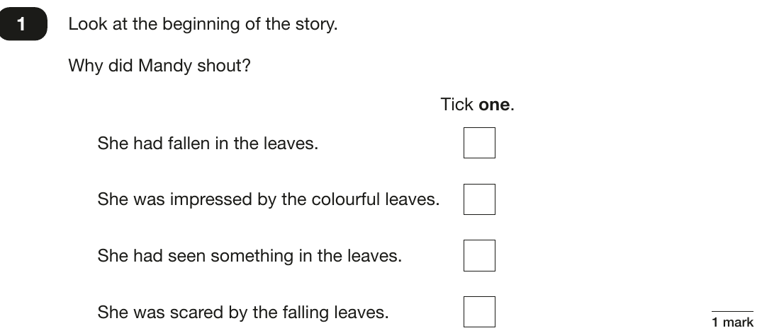
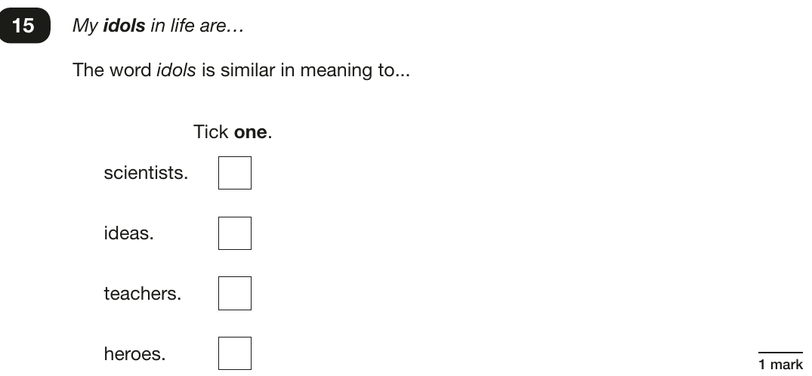
Reading
The reading SATs paper requires a range of answer styles.
Example questions:
Answer
She had seen something in the leaves. ✓
Answer
heroes ✓
Notes:
Questions are from the 2026 reading answer booklet. The reading texts are not shown because they include third-party copyright material.
Question 1 is about the story Owl in Danger; question 15 is about Matilda’s Invention.
Question styles include:
Multiple choice questions
One-word answers
Short answer questions
Multiple mark (long answer) questions

Slide 14
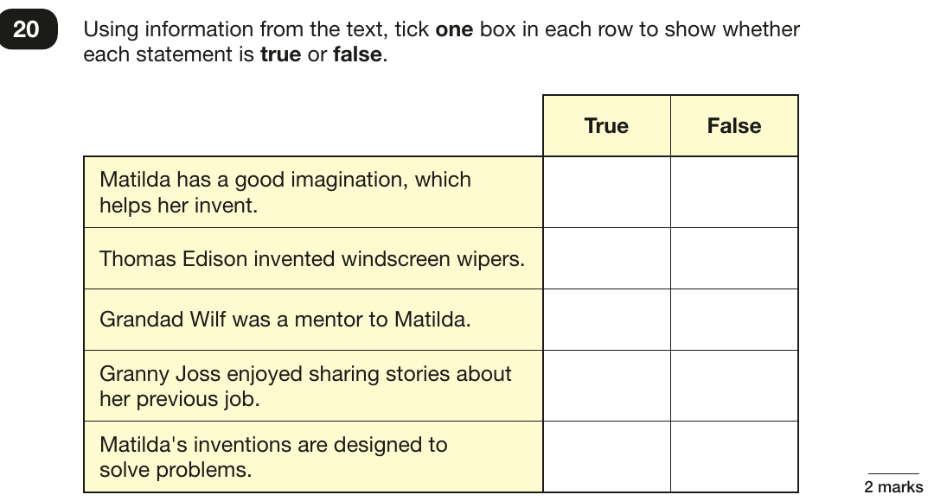
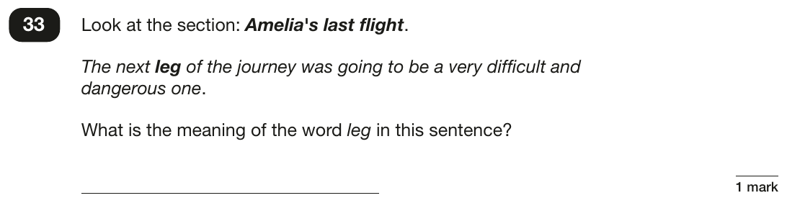
Reading
Example questions:
Answer
A stage or part of the journey (answers such as “a section” or “a stretch” are also accepted).
How it is marked
2 marks for all five rows correct.
1 mark for three or four rows correct.
Notes:
Questions are from the 2026 reading answer booklet. Question 20 is about Matilda’s Invention and question 33 is about Amelia Earhart.
The answers to question 20 depend on the reading text, so they are not shown here. They are in the 2026 reading mark scheme on GOV.UK.
Question 20 shows how children can still earn a mark without getting every row right.

Slide 15
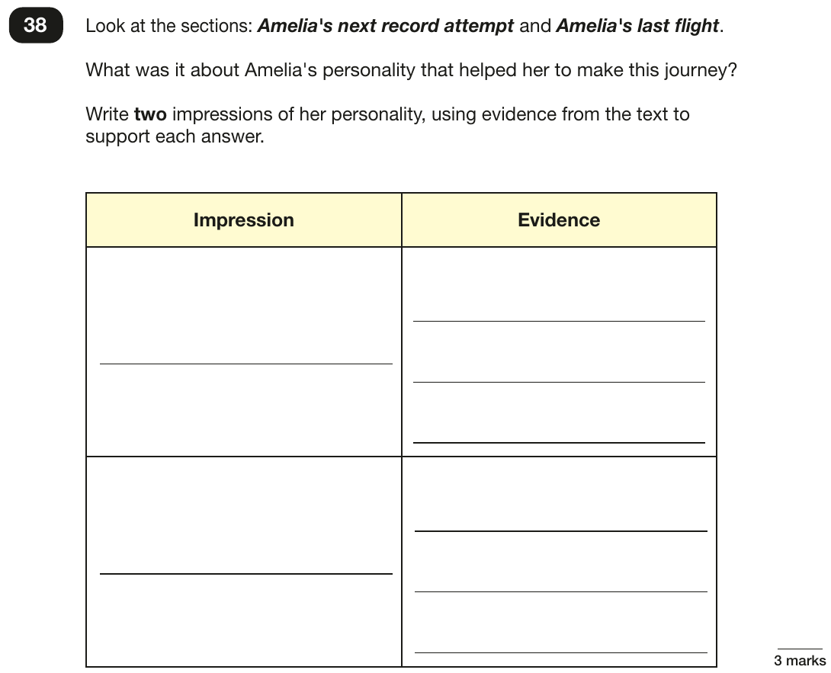
Reading
Example questions:
3 mark question
How it is marked
3 marks: two acceptable impressions, at least one backed up with evidence from the text.
2 marks: two impressions, or one impression with evidence.
1 mark: one acceptable impression.
Example answer
Determined: after her accident in Hawaii, she had her plane repaired and carried on.
Brave: she kept going even though the next leg of the journey was going to be “very difficult and dangerous”.
Other accepted impressions include ambitious, organised and patient.
Notes:
Question 38 from the 2026 reading answer booklet, about the text Amelia Earhart.
Longer inference questions like this are worth up to 3 marks. Children should give a point and then back it up with evidence from the text.

Slide 16
Reading
Since the current format of the SATs began in 2016, three types of question have made up most of the marks.
In the 2026 Reading SATs paper,
10% of marks could be gained from answering questions involving giving and explaining the meaning of words in context;
36% of marks could be gained from answering questions involving retrieving and recording information or identifying key details from a text;
42% of marks could be gained from answering questions involving making inferences from a text and justifying inferences with text evidence.
Together, these made up 88% of the marks, so try focusing on them when you read at home.
Notes:
Figures are calculated from the 2026 reading mark scheme (50 marks in total).
The remaining marks in 2026: 4% summarising main ideas from more than one paragraph; 4% identifying or explaining how information or narrative content is related and contributes to meaning as a whole; 4% identifying or explaining how meaning is enhanced through choice of words and phrases. No marks in 2026 came from predicting what might happen or making comparisons within the text.
The next slide gives parents example questions to ask at home for each of the three main question types.

Slide 17
Reading: questions to ask at home
Try these when you read together. They match the question types worth the most marks.
Word meaning
10% of 2026 marks
Finding information
36% of 2026 marks
Inference
42% of 2026 marks
What does this word mean?
Which word in this paragraph is closest in meaning to…?
Why do you think the author chose this word?
What was [character] doing when [event] happened?
Is this statement true or false? Show me where it says so.
Where did the story take place?
Why do you think [character] did [event]? Can you think of another reason?
How do you think [character] felt? What in the text tells you that?

Slide 18
Maths: Wednesday 12th May and Thursday 13th May
The maths assessments consist of three tests.
Paper 1: Arithmetic (30 minutes) – Wednesday 12th May
Paper 2: Reasoning (40 minutes) – Wednesday 12th May
Paper 3: Reasoning (40 minutes) – Thursday 13th May

Slide 19
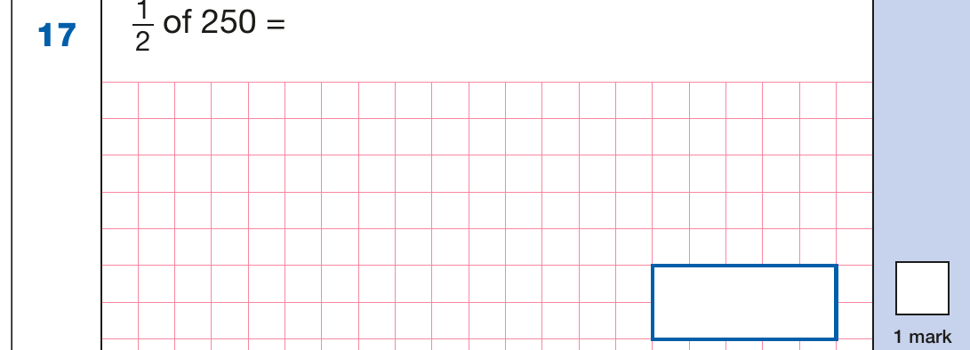
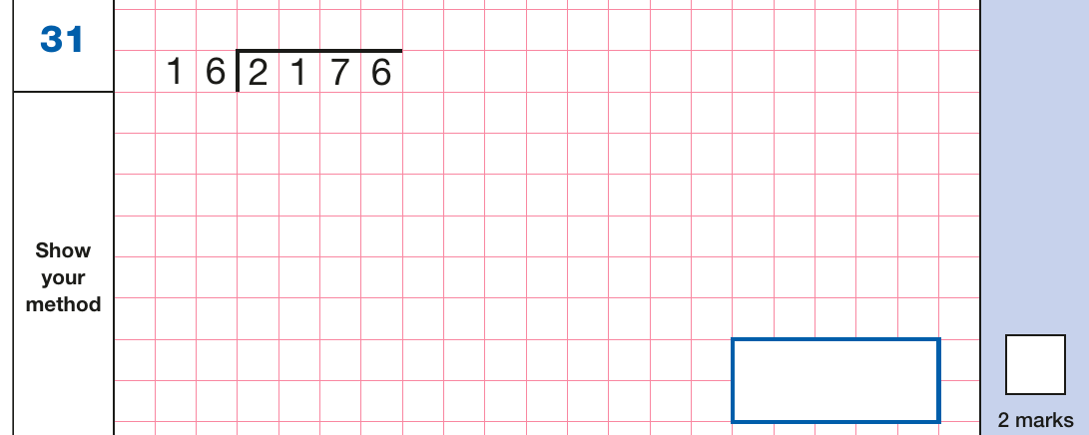
Maths Paper 1 (Arithmetic)
The maths arithmetic paper has a total of 40 marks and lasts for 30 minutes.
The test covers the four operations (addition, subtraction, multiplication, division, including order of operations requiring BIDMAS), percentages of amounts and calculating with decimals and fractions.
Example questions:
Answer
125
Answer
136 (2 marks; 1 mark can be given for a correct formal method)
Notes:
Questions are from the 2026 arithmetic paper (questions 17 and 31).
Point out that some questions are worth 2 marks and some are worth 1. Long division and long multiplication are worth 2 marks, and children may get 1 mark for showing a formal method even if the answer is wrong.

Slide 20
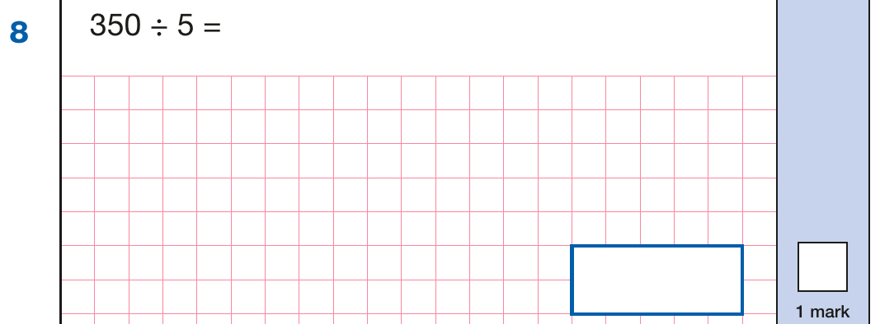
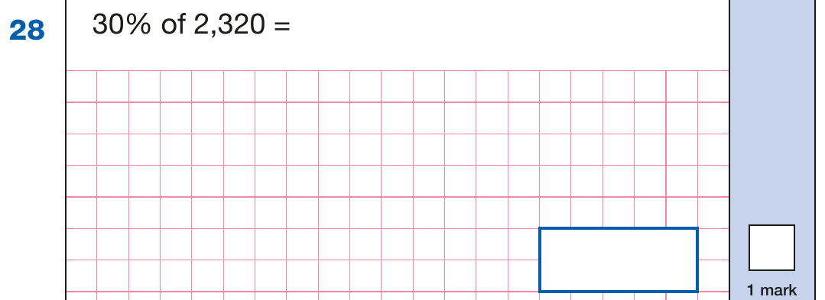
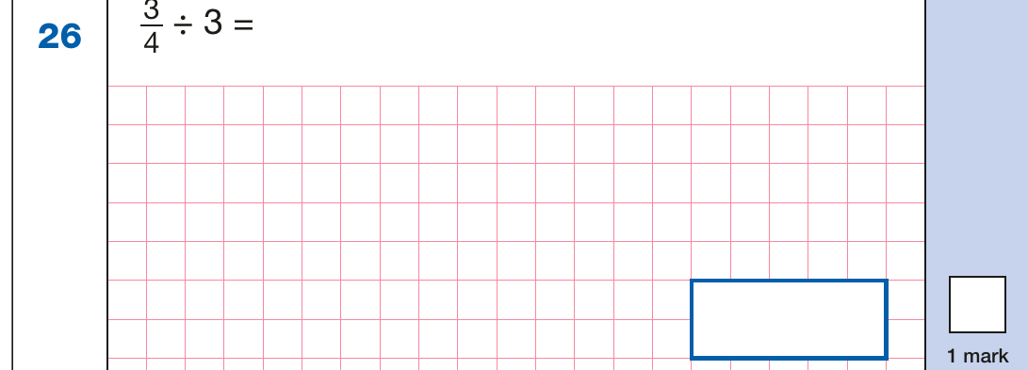
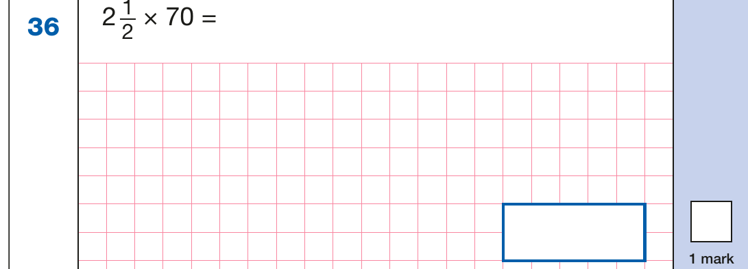
Maths Paper 1 (Arithmetic)
Example 1 mark questions:
Known fact: 35 ÷ 5 = 7
So 350 ÷ 5 = 70
10% of 2,320 = 232
30% = 232 × 3 = 696
70
696
¾ ÷ 3 = ¾ × ⅓
= 3/12 = ¼
2 × 70 = 140
½ × 70 = 35
140 + 35 = 175
¼
175
Notes:
Questions are from the 2026 arithmetic paper (questions 8, 26, 28 and 36).
These are examples of how children could solve the calculations. Some could and should be solved mentally, as it is far quicker that way (40 marks in 30 minutes does not allow for a minute or more per mark).
Answers should always be given in their simplest form unless stated otherwise.

Slide 21
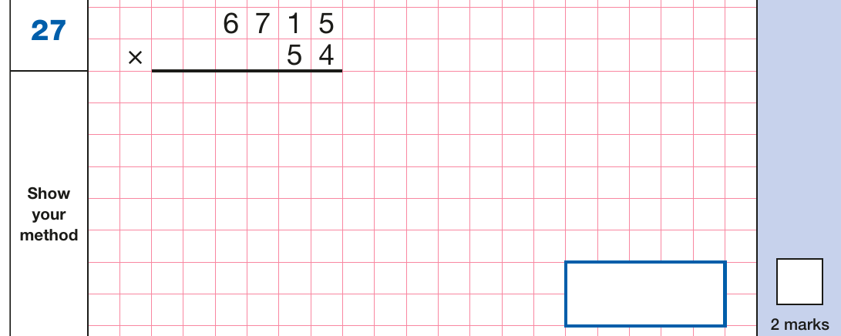
Maths Paper 1 (Arithmetic)
Example 2 mark question:
Worked answer (formal written method)
6 7 1 5
× 5 4
────────────
2 6 8 6 0 (6,715 × 4)
3 3 5 7 5 0 (6,715 × 50)
────────────
3 6 2 6 1 0
Answer: 362,610
2 marks for the correct answer. Children may get 1 mark for showing a formal method, even with a mistake in it.
Notes:
Question 27 from the 2026 arithmetic paper.
This shows why it is worth children always showing their method on long multiplication and long division: a small slip can still earn 1 of the 2 marks.

Slide 22
Maths Papers 2 and 3 (Reasoning)
Paper 2 will take place on Wednesday 12th May and paper 3 will take place on Thursday 13th May. These tests have a total of 35 marks each and lasts for 40 minutes each.
These papers require children to demonstrate their mathematical knowledge and skills, as well as their ability to solve problems and their mathematical reasoning. They cover a wide range of mathematical topics from key stage 2 including,
Number and place value (including Roman numerals);
The four operations;
Geometry (properties of shape, position and direction);
Statistics;
Measurement (length, perimeter, mass, volume, time, money);
Algebra;
Ratio and proportion;
Fractions, decimals and percentages.
Notes:
In general, the questions get progressively harder throughout the paper. As this is the case, it is not unusual for children to be unable to complete the entire paper in the given time.

Slide 23
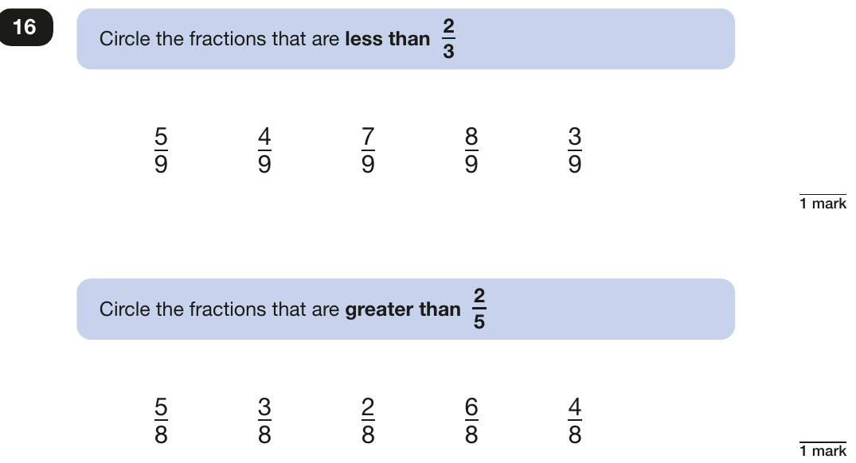
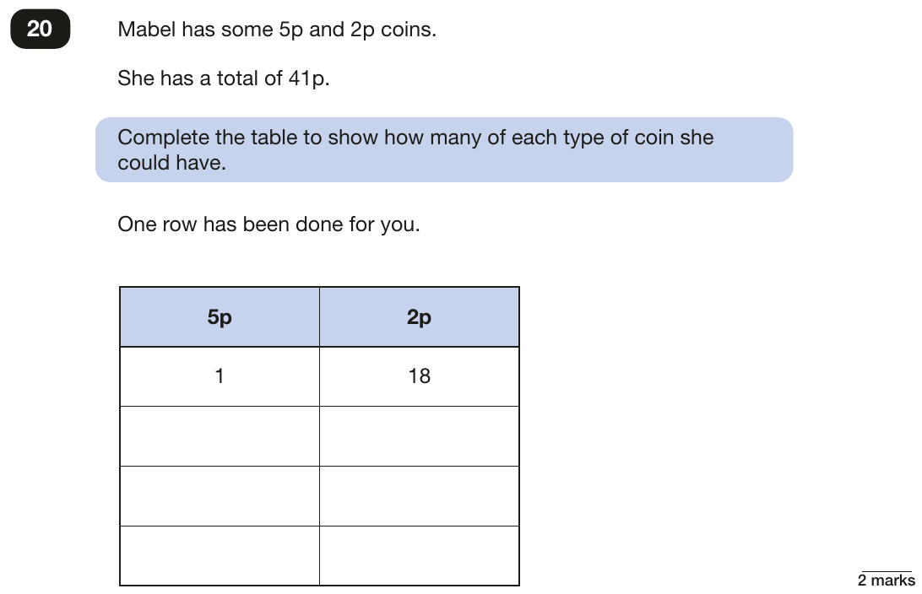
Maths Paper 2 (Reasoning)
Example questions:
Answer
Less than ⅔: 5/9, 4/9 and 3/9
Greater than ⅖: 5/8, 6/8 and 4/8
Answer
3 × 5p and 13 × 2p; 5 × 5p and 8 × 2p; 7 × 5p and 3 × 2p
Notes:
Questions are from the 2026 mathematics paper 2: reasoning (questions 16 and 20).
Question 20 has more than one correct answer. Questions like this reward children who work systematically.

Slide 24
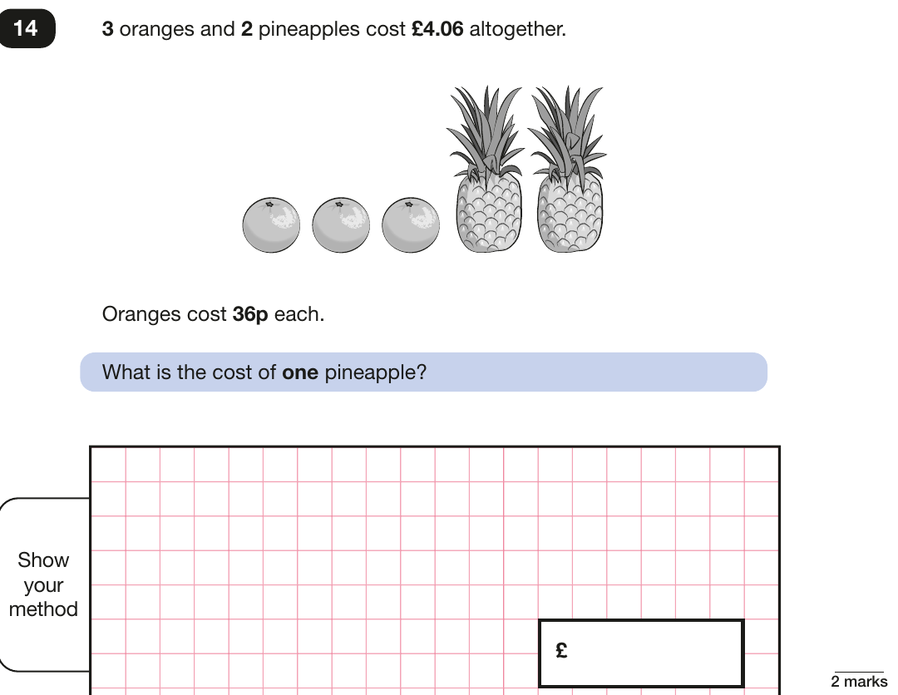
Maths Paper 2 (Reasoning)
Example questions:
Worked answer
3 oranges: 3 × 36p = £1.08
2 pineapples: £4.06 − £1.08 = £2.98
1 pineapple: £2.98 ÷ 2 = £1.49
Answer: £1.49
This is a 2-mark question with a method box. Children can get 1 mark for a correct method, even if the final answer is wrong.
Notes:
Question 14 from the 2026 mathematics paper 2: reasoning.
Multi-step word problems like this are common in the reasoning papers. Encourage children to write down each step.

Slide 25
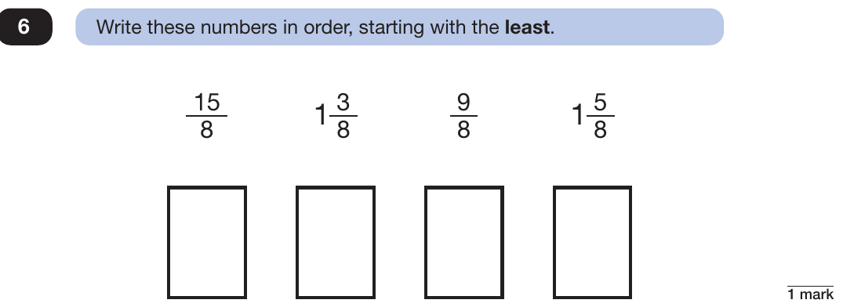
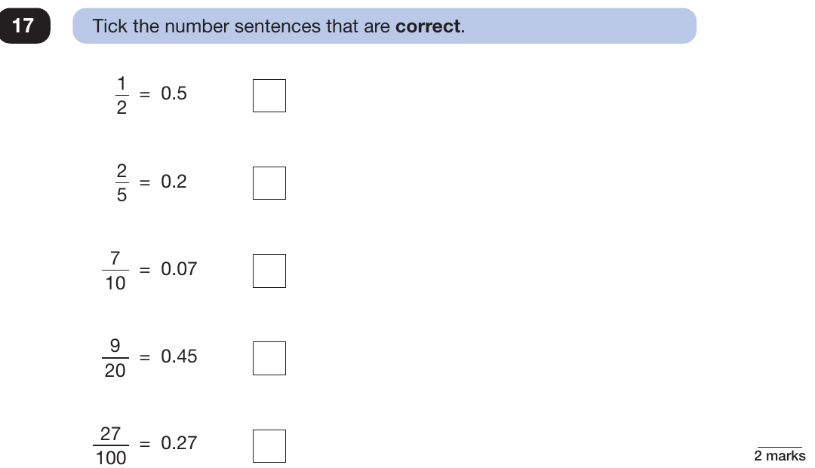
Maths Paper 3 (Reasoning)
Example questions:
Answer
9/8, 1⅜, 1⅝, 15/8
Tip: change them all to eighths: 9/8, 11/8, 13/8, 15/8
Answer
½ = 0.5, 9/20 = 0.45, 27/100 = 0.27 ✓
Notes:
Questions are from the 2026 mathematics paper 3: reasoning (questions 6 and 17).

Slide 26
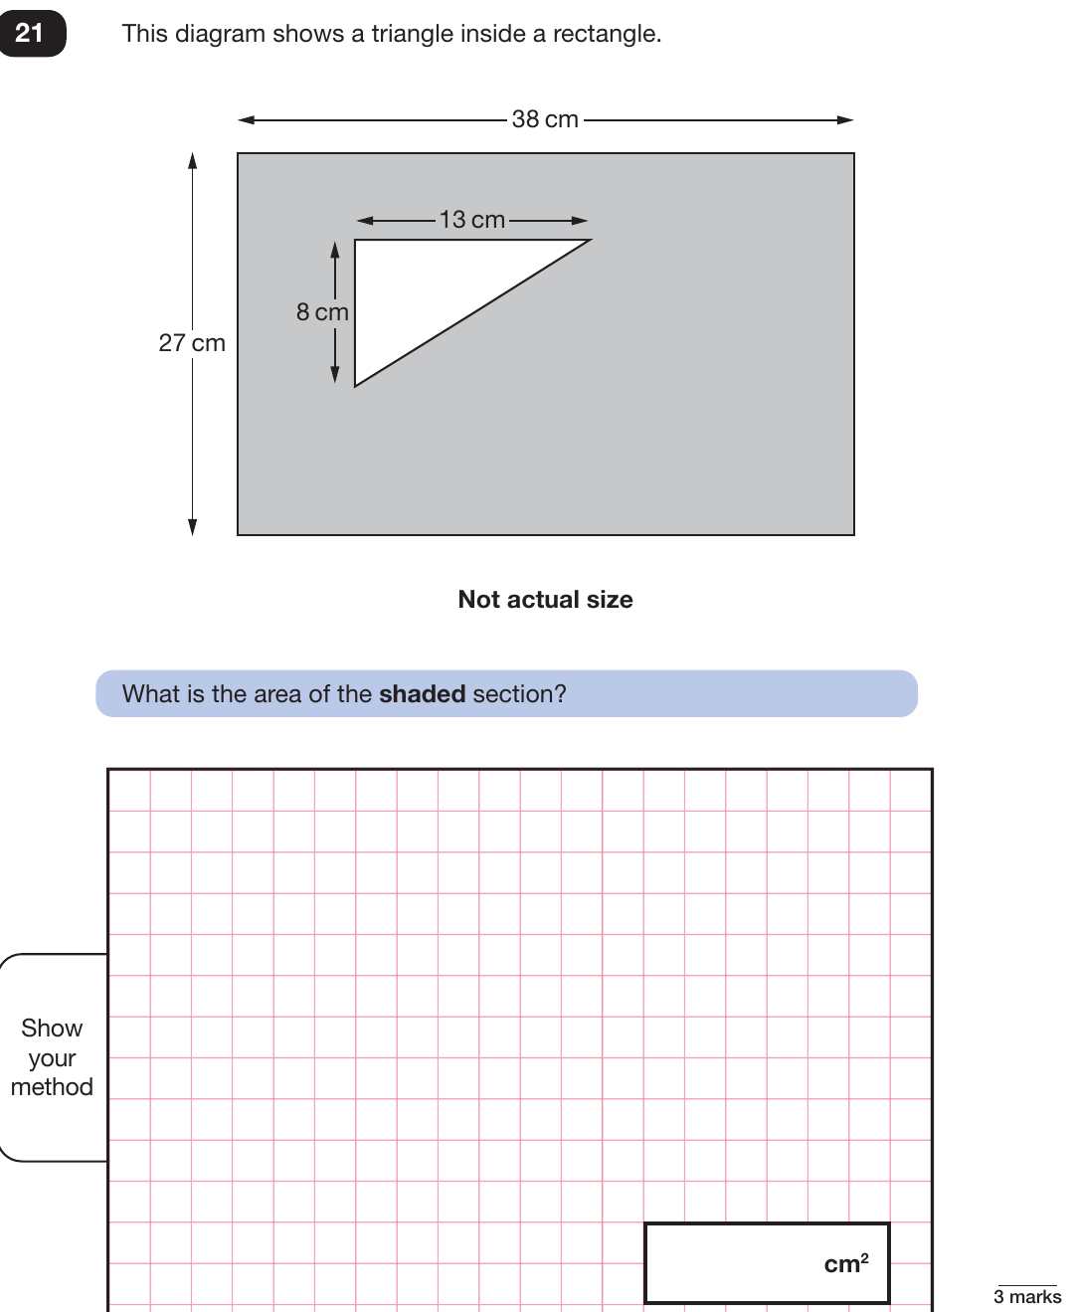
Maths Paper 3 (Reasoning)
Example question:
Worked answer
Area of rectangle: 38 × 27 = 1,026 cm²
Area of triangle: 13 × 8 ÷ 2 = 52 cm²
Shaded area: 1,026 − 52 = 974 cm²
Answer: 974 cm²
This is a 3-mark question. Children can still pick up marks for a correct method, even if the final answer is wrong.
Notes:
Question 21 from the 2026 mathematics paper 3: reasoning.
Note that this is a three mark question.

Slide 27
Writing: how it is assessed
There is no writing test
Your child’s teacher judges their writing using pieces they have written across Year 6, in English and other subjects.
Judged against a national framework
Teachers use the government’s teacher assessment framework to decide whether your child is working towards the expected standard, working at the expected standard or working at greater depth.
Checked by the local authority
Each year, local authorities check a sample of schools’ writing judgements to make sure they are accurate and consistent.
How you can help
Encourage your child to write for real reasons at home, such as cards, lists, diaries or reviews, and to read their writing back to check it makes sense.

Slide 28
Supporting your child in preparing for the SATs
A positive attitude and plenty of encouragement go a long way.
Tips:
Avoid using past papers at home; leave these for school preparation.
Attend school SATs meetings and read informational materials.
Speak directly with the teacher if you have concerns, avoiding worry for your child.
Encourage your child to share anxieties with a trusted adult, remembering mild anxiety is normal.
Provide a quiet, distraction-free study space.
Encourage outdoor time and reduced screen time.
Ensure proper nutrition, hydration, and sleep.
Plan fun weekend activities before and after SATs to help them relax and look forward to something.
Notes:
Encourage parents not to use past papers at home. If they want to use past papers with tutors, suggest that they could take copies of completed test home to work through with tutors. This may help them to work through specific misunderstandings.

Slide 29
Supporting your child in preparing for the SATs
Further tips:
Create a revision timetable that works for you and your child. For some families, 10 to 20 minute activities over a few days works best. For others, a longer study session one day a week might be better.
Keep revision light. Going over key skills (times tables, real world mental maths as you are shopping or cooking) is a good way to keep revision light.
As we said before, avoid using past papers. There are plenty of free or inexpensive SATs practice materials for parents available.
If you’re looking to support your child further with maths at home, there are lots of good websites with free Year 6 revision resources. Start with thirdspacelearning.com/blog/category/for-parents/ or register free for the Third Space Learning Maths Hub (mathshub.thirdspacelearning.com)
Notes:
Note that some schools will want to remove the first bullet point, encouraging pupils not to revise at home and instead keep revision in school.

Slide 30
Things to remember about SATs
SATs focus on what children know about Maths and English.
They will not reflect how talented they are at science, geography, art, PE…, and they certainly won’t highlight all their amazing personal characteristics.
SATs don’t tell the whole story.
Their results will say whether they met the expected standard, but not everything they can do. The number of marks needed to reach the expected standard changes each year depending on how hard the paper is, but the standard itself stays the same. Your school may be able to provide you with more detailed feedback.
SATs are only four days out of a whole Primary School career.
In reality, there's one or two papers each day that last 30 to 60 minutes.

Slide 31
What to do if you are worried about your child
SATs often induce a certain degree of worry or anxiety but there is, of course, a tipping point.
SATs anxiety should not:
Affect a child’s appetite
Affect a child’s sleep
Affect a child’s personality
Induce panic, tears or disengagement from lessons or hobbies
Be a reason not to attend school.
If any of the above are evident, SATs may be causing an excessive degree of anxiety and may benefit from some additional support. This isn’t about removing the reality of SATs but rather equipping your 10 or 11 year old with the ability to better cope with the situation.

Slide 32
What to do if you are worried about your child
Talk to the school
Sometimes concerns present at home and not at school. If you notice a change in your child, talk to the school so that everyone concerned can offer the support needed.
Talk to your child
Talk to your child about what aspect of SATs concerns them the most. If you can help them pinpoint what is bothering them the most, you can take specific steps to help reassure them.
Encourage your child to talk to their teacher
SATs are obviously linked to school. Don’t be surprised if your child would prefer to seek reassurance from teachers over family members.
Try not to project your own anxieties or views about the SATs
Children can be very intuitive. If they see that you are anxious, this could add to their own anxieties. Similarly, if you don’t believe in SATs, your child may reflect this view.
Notes:
It may also be appropriate to discuss if there are any changes at home that could add stress to the child (e.g. moving house, a new sibling, recent bereavement).
There may be media coverage around the SATs, parents may want to discuss this with their children (positive or negative).

Slide 33
Advice for Year 6 children
Listen to your teacher.
The adults you work with all want you to do your best.
Get plenty of sleep and eat well, this will help your brain.
Read all the questions carefully. This can help you to avoid silly mistakes.
Don’t panic. There may be questions you think you can’t answer. Take a deep breath. Read it again. You can always move on and go back to it later. It’s often better to write something rather than nothing.
Remember that the Year 6 SATs last for 4 days out of your whole life!
“Stay focused in class so you don’t have loads of extra studying to do at home!” – Year 7 pupil’s advice.

Slide 34
Supporting your child with maths at home
✓ Free maths guides for parents, from times tables to SATs revision: thirdspacelearning.com/blog/category/for-parents
✓ Register free for the Third Space Learning Maths Hub: mathshub.thirdspacelearning.com
✓ Practise times tables little and often. Quick recall helps with every maths paper.
✓ Talk about maths in everyday life: shopping, cooking, telling the time and planning journeys.
Find out more about the SATs
Official information for parents from the Department for Education: GOV.UK key stage 2 tests: information for parents
Any questions about your child? Speak to their class teacher.
Notes:
Closing slide for parents. Schools can add their own contact details or next steps here.

